Slide 1
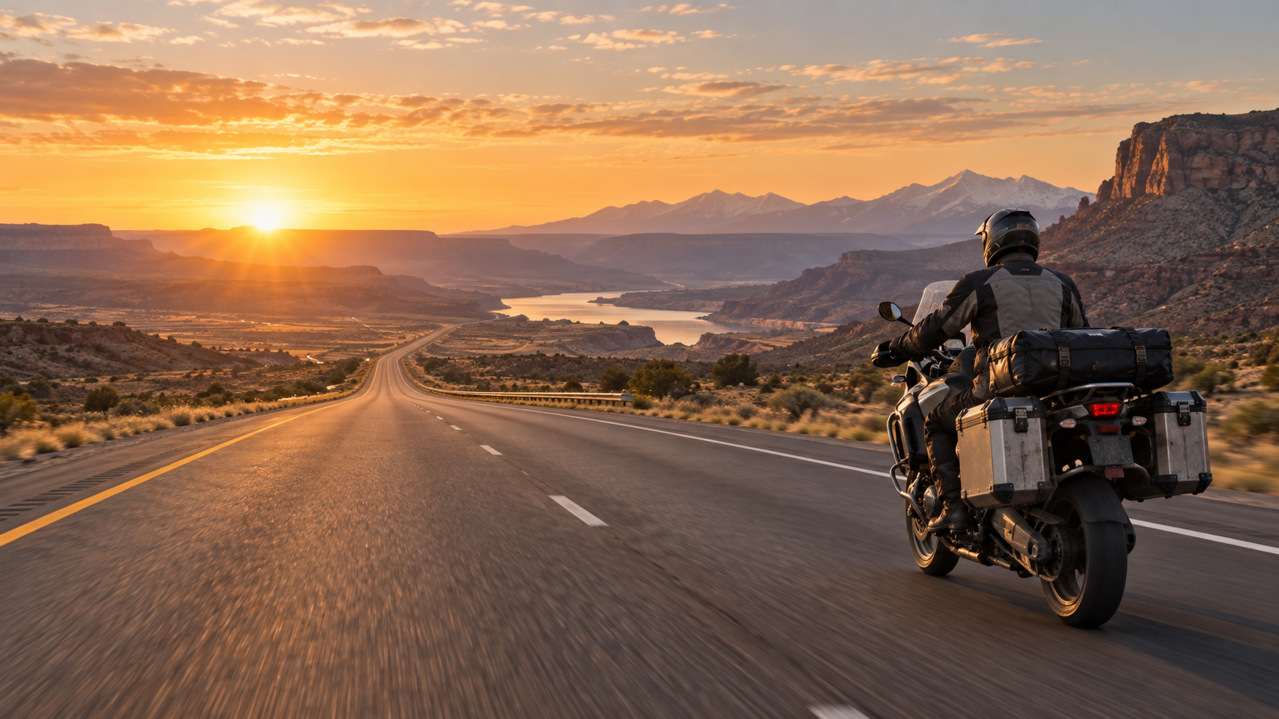
LONG-DISTANCE ENDURANCE RIDING
PLAN • PREPARE • EXECUTE
How to plan, prepare and successfully execute an Iron Butt Association certified ride
Greg Rice
Long-distance endurance rider • gregrice.com
Safety first. Documentation always. Consistency beats speed.
Notes:
• Open by framing the session around three disciplines: planning, preparation and execution.
• The objective is not speed. The objective is a safe ride that meets the certification requirements and is properly documented.
• This deck blends current IBA rules, IBA community knowledge, and lessons from Greg Rice’s own certified rides.

Slide 2
THE MISSION
Three things have to go right
A successful endurance ride is a system — not a single heroic effort.
1 Get home safe
2 Meet the ride requirements
3 Prove what you did
Every decision is subordinate to safety. A failed certification is recoverable; an unsafe decision may not be.
Distance, elapsed time, route and any ride-specific rules all have to line up.
Receipts, photos, logs and route evidence turn a long ride into a certifiable IBA ride.
Think of the ride as an operating system: ROUTE + TIME + RIDER + BIKE + DOCUMENTATION.
Sources: Iron Butt Association — SaddleSore 1000/Bun Burner 1500 guidelines; IBA Documentation Guidelines v7.3 (June 2026).
Notes:
• Use this slide to separate “riding far” from “earning a certification.”
• IBA documentation guidance explicitly prioritizes getting home safe, complying with the specific ride rules, and proving the claim.

Slide 3
START HERE
The rules define the plan
Read the current page for the exact ride you intend to certify before you build the route.
1,000
1,500
300
MILES
MILES
MILES
SaddleSore 1000
Bun Burner 1500
Maximum between fuel/documentation stops
< 24 hours
< 36 hours
for large-tank SS/BB claims
Current U.S. SaddleSore/Bun Burner guide: Version 6.4, revised August 13, 2026.
The IBA maintains ride-specific rules and they can change.
Source: Iron Butt Association — SaddleSore 1000 / Bun Burner 1500, Version 6.4, revised Aug. 13, 2026.
Notes:
• These figures are examples from the core U.S. SaddleSore/Bun Burner series; other IBA rides have different route, proof and tracking requirements.
• The 300-mile stop rule matters to riders with auxiliary fuel or large tanks because documentation still has to occur.

Slide 4
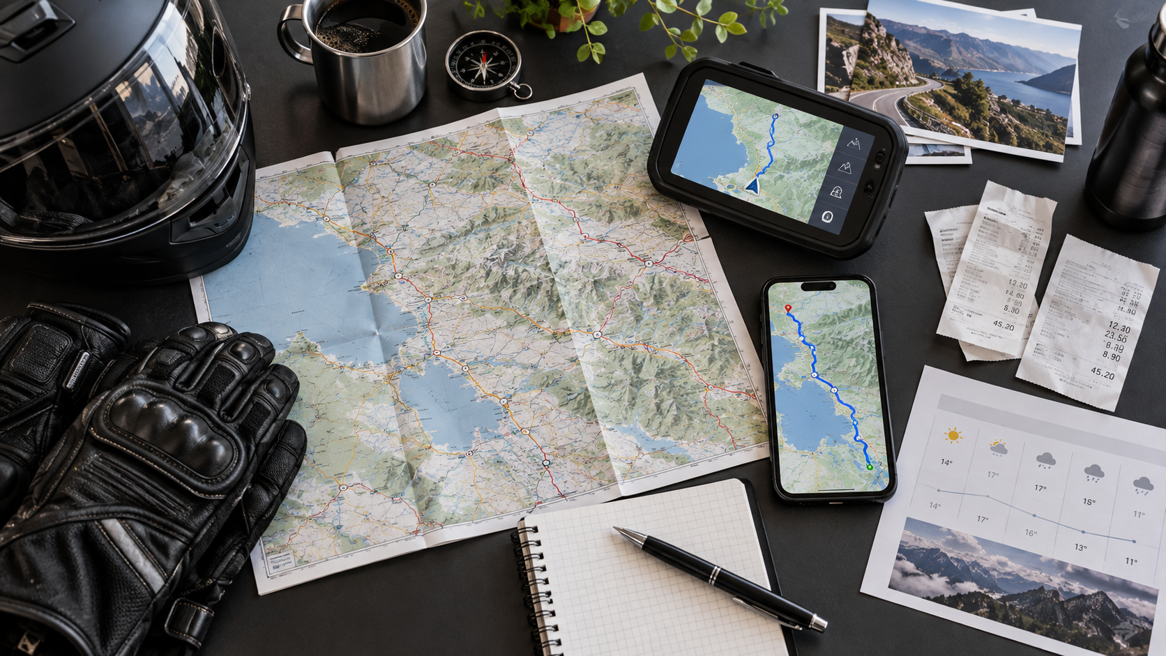
01
PLAN
Build a ride that works on paper first
Your route must be safe, achievable, documentable and resilient when reality changes.
Greg Rice • gregrice.com

Slide 5
PLAN
Plan from the certificate backward
The finish line is defined before the motorcycle ever moves.
1
2
3
4
5
Choose the ride
Read the exact rules
Map proof points
Build the time budget
Add backup options
Design question
Operational question
“What evidence will prove I was here, at this time, on this route?” Build those points into the ride rather than improvising them at 2:00 a.m.
“What do I do when the preferred fuel stop, road, weather window or piece of technology fails?”
Sources: IBA Documentation Guidelines; Iron Butt Forum planning discussions; GregRice.com ride-planning pages.

Slide 6
ROUTE
Choose the easiest safe miles — not the prettiest line
The ride is already hard. Do not make the route harder without a reason.
Road type
Traffic windows
Fuel coverage
Favor roads that support a legal, steady pace and have predictable services.
Route around commuter bottlenecks, events, holiday traffic and known chokepoints.
Know the real spacing between reliable stations — including late-night availability.
Weather exposure
Construction
Time & daylight
Check heat, cold, wind, storms, fog and mountain conditions along the entire time window.
State DOT / 511 systems can reveal lane closures and long work zones before departure.
Account for time zones, sunrise/sunset and the fatigue cost of night riding.
Sources: IBA route guidance; Greg Rice — Coast-to-Coast weather/DOT planning and IBA ride pages.

Slide 7
TIME
The secret is not speed — it is time management
Overall average speed includes every fuel stop, receipt problem, meal, traffic jam and rest break.
Example only: 1,000-mile ride at a 68 mph moving average
Build your own time budget
• Real moving average
• Number of fuel stops
• Typical stop duration
• Meal strategy
• Planned rest
• Traffic / weather margin
• Documentation time
14h 42m MOVING
5h 18m STOP / CONTINGENCY MARGIN
20-hour finish
14h 42m MOVING
3h 18m STOPS
18-hour finish
Lost time should be recovered by simplifying stops or changing the plan — never by “making it up” with speed.
IBA guidance emphasizes that these rides do not require speeding. Time-budget example is illustrative, not a target pace.

Slide 8
FUEL
Fuel stops are both logistics and evidence
Know where you expect to stop, where you can stop, and what proof you need to leave with.
1
Use a conservative usable range
2
Have a backup station
3
Make the stop routine repeatable
Plan from a repeatable real-world range, not the best number the motorcycle has ever shown.
Especially at night, remote corridors and small towns. A “24-hour” pin on a map is not enough.
Fuel → receipt → inspect receipt → photo → log → hydrate/stretch → depart.
4
Document the route corners
5
Protect the receipt
6
Remember the 300-mile rule
Turnarounds and route-defining locations need proof sufficient to establish the route.
Do not discover 12 hours later that the city, date or time is unreadable.
For the core U.S. SS/BB guidelines, large-tank motorcycles still need at least one fuel/documentation stop every 300 miles.
Sources: IBA SaddleSore/Bun Burner guidelines; IBA Documentation Guidelines; Iron Butt Forum fuel-planning discussions.

Slide 9
INTELLIGENCE
Know what is waiting 500 miles ahead
Greg Rice’s planning process combines weather, traffic and construction data before departure — then keeps checking it during the ride.
Heat • cold • wind • storms
What is moving into your path?
WEATHER
RADAR
Do not plan only for the start city.
Time a stop or route change before the storm owns you.
Closures • work zones • incidents
Rush-hour windows • events
DOT / 511
TRAFFIC
Mark known problem areas before you leave.
A 20-minute bottleneck can become a 90-minute problem.
Operational advantage
A rider who already knows where the construction zones, fuel gaps and weather fronts are can make decisions calmly — before time pressure and fatigue arrive.
Source: Greg Rice — Coast 2 Coast planning page and IBA rides page (weather, radar, DOT construction research and GPS alerts).

Slide 10
PROOF
Design a route that is easy to verify
The easier your claim is to understand, the less time you spend explaining it after the ride.
Every proof point should answer
Where? • When? • Which direction / route?
FINISH
CORNER
Good redundancy
Receipt + odometer photo + geotag / track creates a much stronger record than any one item alone.
TURN
When proof fails
START
Photograph the business, address or GPS location and document the situation as well as you can.
Source: IBA Documentation Guidelines v7.3 — the rider is responsible for proving presence, time and compliance with the ride rules.

Slide 11
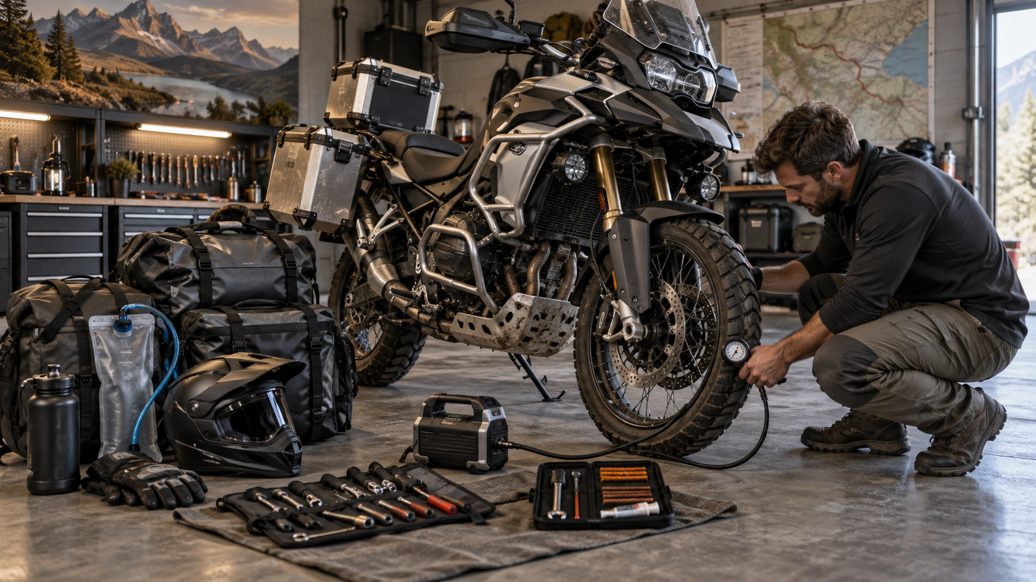
02
PREPARE
Make the bike and rider boringly reliable
A long-distance ride is the wrong place to discover a new mechanical issue, new gear problem or new personal limit.
Greg Rice • gregrice.com

Slide 12
MOTORCYCLE
Start with a known, sorted motorcycle
Reliability beats novelty. Finish all changes early enough to test them on real rides.
TIRES
FASTENERS / CONTROLS
Enough tread for the entire ride plus contingency. Correct pressure, no mystery punctures.
Nothing loose, sticking or newly installed the night before.
BRAKES / FLUIDS
LIGHTS / VISIBILITY
Inspect pads, fluid levels, leaks and service status.
Headlights, brake lights, reflectivity and night-ride readiness.
ELECTRICAL
PRE-RIDE CHECK
Battery health, charging system, lighting, accessory loads and fuses.
Use a repeatable inspection routine such as T-CLOCS or your own equivalent.
IBA “Archive of Wisdom” principle: prepare the motorcycle before the trip — and avoid last-minute maintenance or accessories.
Sources: IBA Archive of Wisdom; Motorcycle Safety Foundation pre-ride guidance.

Slide 13
CONTINGENCY
Carry enough to solve the likely failures
You do not need a rolling workshop — you need a compact kit matched to your motorcycle and route.
Flat repair
Air
Basic tools
Electrical
Plug / patch system you have actually practiced using.
Compact compressor plus pressure gauge.
Fasteners and adjustments unique to your motorcycle.
Fuses, small meter/test light, charging cables.
Light
Power
Recovery
Bike-specific spares
More than one flashlight/headlamp for roadside work at night.
Portable battery pack for phone / headset / GPS emergencies.
Towing / roadside plan — and a realistic understanding of remote coverage.
Only the small parts that commonly strand your model or setup.
Sources: Greg Rice — Mexico SS1000 preparation advice; IBA Archive of Wisdom.

Slide 14
RIDER
Prepare the rider before the clock starts
Fatigue management begins before the motorcycle leaves the driveway.
SLEEP
HYDRATION
FOOD
Start rested. Do not turn ride day into the second half of an already-long day.
Begin hydrated and make small, regular intake easy from the saddle or stops.
Choose familiar foods that support steady energy without creating long stops.
CLOTHING
HEARING
MINDSET
Layer for the coldest and hottest conditions you may see, not just the forecast at home.
Wind noise adds fatigue; hearing protection can reduce noise load.
Be willing to abort. The plan is a tool, not a command.
IBA: no rider — regardless of experience — can safely “fight off” fatigue. If you are tired, stop and rest.
Sources: IBA SaddleSore/Bun Burner guidelines; IBA Archive of Wisdom; NHTSA drowsy-driving guidance; MSF rider-safety guidance.

Slide 15
COMFORT
Comfort is a safety system
Small irritations become big distractions after 12, 16 or 20 hours.
Wind
Hands
Screen height / airflow / neck load
Grip diameter / throttle effort / gloves
Seat
Feet & knees
Known seat / pressure management
Peg position / room to move
Temperature
Hydration
Heated or cooling gear ready before needed
Easy access without turning every drink into a 15-minute stop
Rule of thumb: fix hot spots, pressure points, noise and control effort during training rides — not during the certification attempt.
Sources: IBA Archive of Wisdom; MSF safety guidance; long-distance rider practice.

Slide 16
NAVIGATION
Redundancy prevents small failures from becoming ride-ending failures
A route is only useful if you can still navigate it after one device, cable or data connection stops working.
PRIMARY GPS
PHONE / BACKUP
HIGH-LEVEL ROUTE
Main route and waypoints
Offline map + alternate routing
A simple overview you can understand without electronics
POWER
TRACKING
Bike power + backup battery / cable
SpotWalla / satellite / app as backup or when the ride requires it
Do not let “technology redundancy” become “distraction redundancy.” Configure it before departure and keep the cockpit simple.
Sources: Greg Rice planning pages (multiple GPS / tracking); IBA ride pages where tracking may be ride-specific.

Slide 17
DOCUMENTATION
Make documentation part of the cockpit workflow
The best time to discover your camera timestamp, receipt process or log system is wrong is before the start receipt.
✓
Correct ride rules saved / accessible
✓
Trip log ready
✓
Phone camera location metadata enabled if useful
✓
Folders / naming system for receipt photos
✓
Start / end / corner proof plan
✓
Pen, backup pen, small envelope or receipt storage
✓
Tracking link tested if used
✓
Emergency contacts and route shared
Build the habit now: every stop ends with “Do I have the proof?”
Source: IBA Documentation Guidelines v7.3; IBA forum certification discussions.

Slide 18
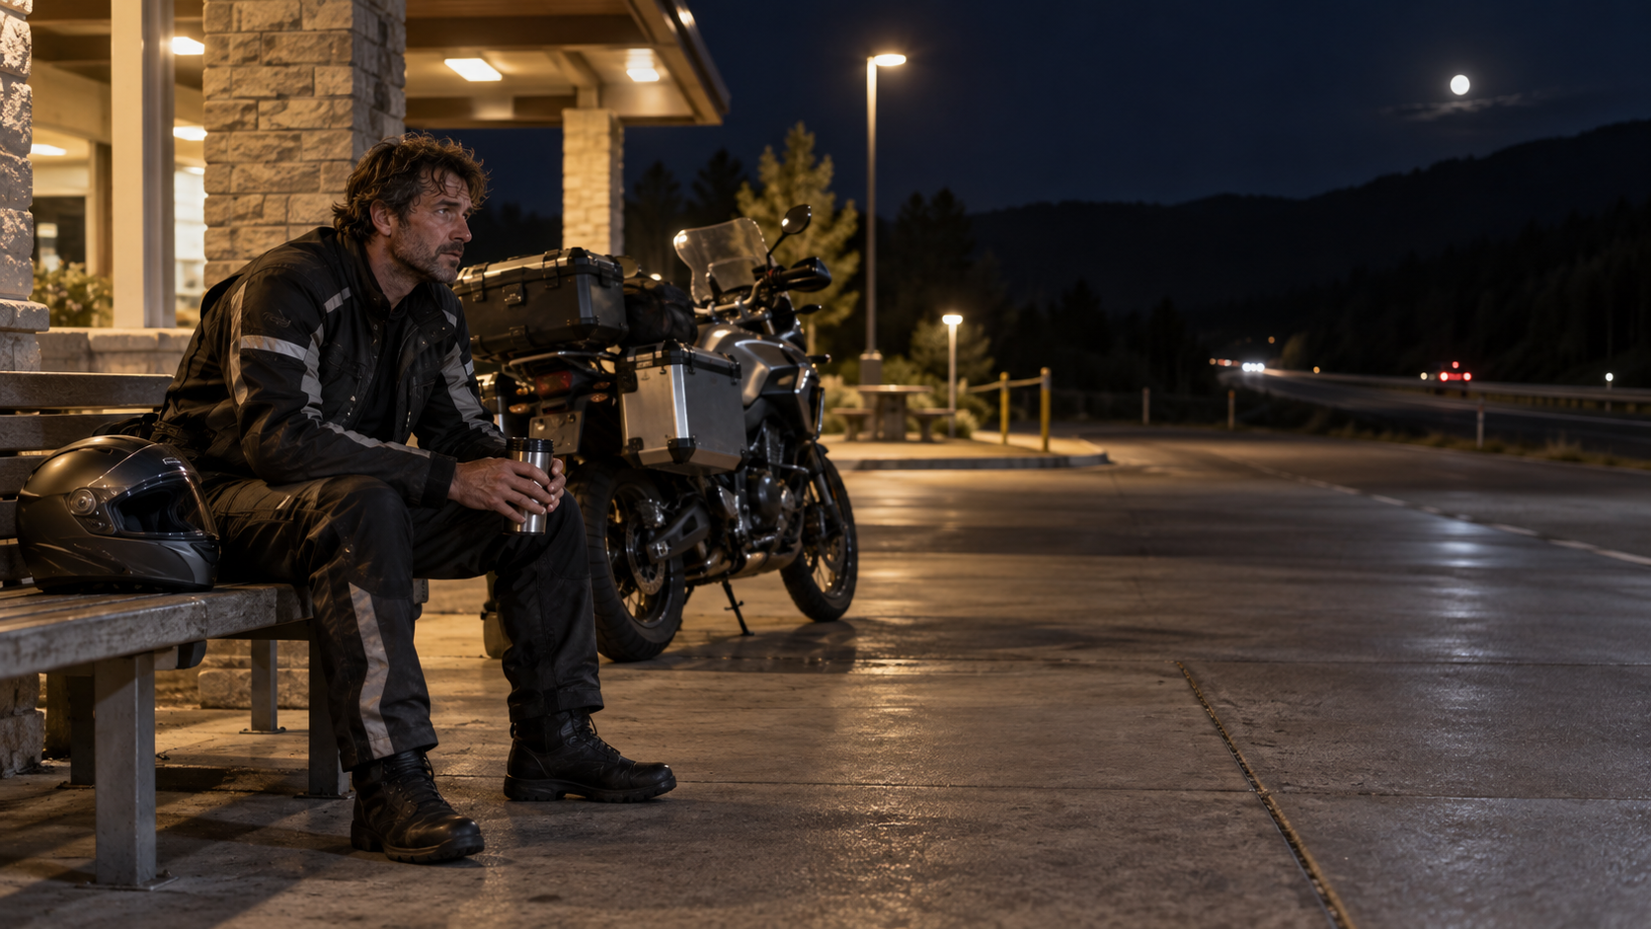
03
EXECUTE
Ride the plan — and know when to abandon it
Execution is disciplined repetition: legal pace, efficient stops, continuous self-assessment and complete documentation.
Greg Rice • gregrice.com

Slide 19
START
The ride begins with a clean evidence chain
A disciplined start prevents the most frustrating kind of failure: finishing the miles but losing the certification on paperwork.
1
2
3
4
5
Bike ready
Start DBR
Photo
Log it
Roll
Fuel, pressures, lights, gear, navigation.
Obtain a computer-generated start receipt that clearly establishes place and time.
Photograph the receipt with the odometer as required/recommended for the ride.
Record the stop while you are still there.
Ride the plan; the clock is now real.
Practical rule
Never ride away from a critical documentation stop until you have looked at the actual receipt and the actual photo.
Source: IBA Documentation Guidelines; current SaddleSore/Bun Burner short-form documentation process.

Slide 20
PACE
Ride a steady legal pace and protect your time bank
The best endurance pace feels almost boring — until you realize how much time chaos costs.
TIME
Legal pace
CONSISTENT
Do not chase time with speed.
Short predictable stops
The routine should be practiced and repeatable.
Eat smart
STOP CREEP / PROBLEMS
Do not turn every fuel stop into a restaurant stop.
MILES
Check the clock
Know your overall average, remaining margin and next decision point.
Sources: IBA Archive of Wisdom (“stop to go faster,” separate gas/food stops); IBA safety guidance.

Slide 21
STOPS
A sample fast-but-complete fuel stop routine
Efficiency comes from order and repetition — not rushing. Adapt the sequence to the specific ride rules.
1
2
3
4
5
6
ARRIVE
FUEL
RECEIPT
PHOTO
LOG
RESET
Safe position
trip / clock check
Fill efficiently
no wandering
Print and inspect
city • date • time
Receipt + odometer
clear and readable
Record stop
while it is fresh
Drink / stretch
scan bike / depart
The “fastest” stop is the one you never have to reconstruct later.
Target times vary by rider, motorcycle and documentation requirements. Practice the workflow instead of chasing a magic number.
Sources: IBA Documentation Guidelines and long-distance rider practice.

Slide 22
FATIGUE
Fatigue is a stop condition — not a character test
By the time you are negotiating with yourself about whether you are tired, you should already be looking for a safe place to stop.
GREEN
YELLOW
RED
ALERT
DEGRADED
STOP
Normal scanning, smooth decisions, comfortable pace.
Repeated yawning, wandering attention, missed signs/exits, irritability, poor lane discipline.
Pull off safely and rest. Do not use speed, willpower or stimulants as a fatigue-management strategy.
Sources: IBA SaddleSore/Bun Burner safety guidance; NHTSA drowsy-driving guidance.
Notes:
• The IBA specifically says fatigue cannot be safely fought off; the correct response is to stop and rest.
• NHTSA similarly emphasizes adequate sleep and pulling off when drowsy.
• The symptom examples here are practical warning signs, not a medical diagnostic checklist.

Slide 23
ADAPT
When the plan breaks, protect the rider first
Long rides always create surprises. Your contingency plan determines whether the surprise becomes a disaster.
Receipt printer fails
Road closes
Photograph your location, the business and whatever proof is available; make a log note immediately.
Reroute legally and re-check both distance and time. Add proof if the route becomes ambiguous.
Storm blocks the corridor
Mechanical problem
Stop, wait or detour. Weather is allowed to “win.”
Fix only what is safely within your capability; use roadside recovery when it is not.
Rider is fading
Time margin disappears
The ride is over until the rider is safe to continue — certification pressure is irrelevant.
Change the goal. Do not convert a schedule problem into a speed or fatigue problem.
A ride can fail on paper and still be a successful decision.
Sources: IBA Documentation Guidelines (“document your position as best you can”); IBA safety guidance.

Slide 24
GROUP RIDES
A group adds support — and new risk
IBA guidance specifically warns that group dynamics can pressure riders to continue when they would otherwise stop.
BEFORE THE RIDE
DURING THE RIDE
THE NON-NEGOTIABLE
Agree on pace, fuel range, stop duration, passing behavior, communication and what happens if a rider stops.
Ride your own motorcycle. Keep safe spacing. Do not turn a rider’s short stop into a debate or a group vote.
Every rider owns the right to slow down, rest, change the plan or end the ride without pressure from the group.
The group is only successful if every rider finishes safely — even when “finish” means stopping early.
Sources: IBA SaddleSore/Bun Burner group-ride warning; Motorcycle Safety Foundation group-riding guidance.

Slide 25
FINISH
Finish the evidence chain before you celebrate
The ride is not administratively finished until the end proof, photos and log are secure.
END DBR
VERIFY
PHOTO
Obtain the required end receipt before the time window closes.
Read city, date and time — do not assume the printer got it right.
Capture the receipt / odometer proof clearly.
BACK UP
LOG
SUBMIT
Copy photos, track and notes while they still exist on multiple devices.
Finish the trip log and explain unusual stops or documentation issues.
Use the current IBA submission process and include the required route / documentation package.
Electronic submission is preferred where the ride page allows it. Follow the current ride page, not an old checklist.
Sources: IBA SaddleSore/Bun Burner v6.4; IBA Documentation Guidelines v7.3.

Slide 26
EXPERIENCE
What Greg Rice’s ride history says about preparation
More than 100 certified IBA rides — including 90+ Bun Burner Golds — built around the same basic discipline.
Up-front planning
130+
Research the route, weather and traffic before the ride instead of solving predictable problems during it.
IBA-certified rides
Construction awareness
Greg checks state DOT sites and can mark major work zones in his GPS so the slowdown has context.
97
Prepared for roadside problems
Bun Burner Golds
Tire repair, compressor, lights, charging and recovery items are selected because long routes can put help far away.
The lesson is not the mileage count. The lesson is repeatability.
Sources: GregRice.com — My Iron Butt Association Rides; Mexico SS1000 Ride; Coast 2 Coast planning page.

Slide 27
TAKEAWAYS
Ten rules to remember
A compact checklist for the next time you build a certified long-distance ride.
1
Read the current ride rules first.
6
Keep fuel stops repeatable.
2
Build mileage and time margin.
7
Monitor weather and road conditions.
3
Plan the documentation with the route.
8
Do not recover lost time with speed.
4
Use a known, tested motorcycle.
9
Stop when fatigue appears.
5
Start genuinely rested.
10
Protect and back up your evidence.
PLAN IT. PREPARE IT. RIDE IT. DOCUMENT IT. GET HOME SAFE.

Slide 28
RESOURCES
Primary resources used in this presentation
Always re-check the specific IBA ride page before an actual attempt.
Iron Butt Association
SaddleSore 1000 / Bun Burner 1500 — Version 6.4, revised Aug. 13, 2026
https://www.ironbutt.com/themerides/ssseries/
Iron Butt Association
Documentation Guidelines — Version 7.3, June 2026
https://www.ironbutt.com/themerides/documentation/
Iron Butt Association
Archive of Wisdom — long-distance riding tips from IBR veterans
https://www.ironbutt.com/ibmagazine/IBMag01-200.pdf
Iron Butt Forum
Rider Preparation, certified ride reports and planning discussions
https://forum.ironbutt.org/
Greg Rice
IBA rides, ride planning, weather / DOT research, equipment and ride reports
https://www.gregrice.com/rides/rides.html
NHTSA / MSF
Drowsy-driving and motorcycle pre-ride / safety guidance
https://www.nhtsa.gov/risky-driving/drowsy-driving • https://msf-usa.org/
Presentation note
IBA rules and documentation can change. The official ride page is the authority for a real certification attempt.

Slide 29
THE BEST LONG-DISTANCE RIDE
ENDS WITH YOU HOME SAFE.
Questions / discussion
Greg Rice • gregrice.com
Plan it. Prepare it. Execute it. Document it.

