Slide 1
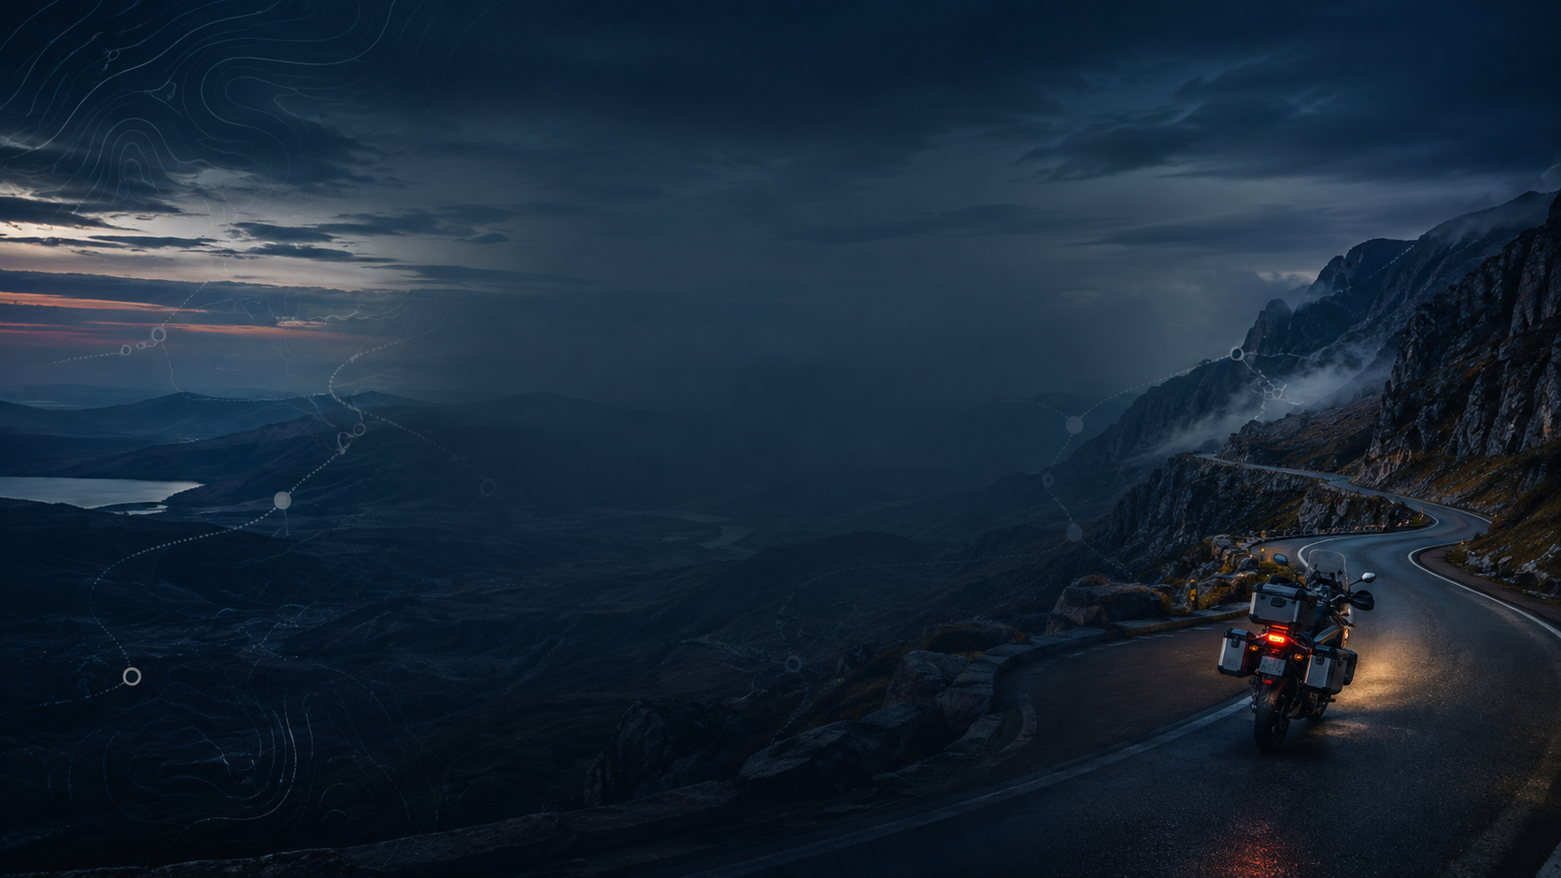
IRON BUTT ASSOCIATION • BIG AS TEXAS 2026
RALLY PLANNING
Plan the Rally.
Ride the Plan.
How to approach, plan & prepare for long-distance endurance motorcycle rallies
PLAN THE RIDER YOU ARE
not the rider you hope to be at 2 a.m.
Greg Rice • Allen, Texas • September 2026
How I get ready, plan my route and ride the rally — and what I learned the hard way.
Notes:
Welcome everybody. I'm Greg Rice, and I've been riding motorcycles since the early 1970s and riding rallies since 2005. Thanks to the Iron Butt Association for asking me to do this.
Here's what we're going to talk about: how I get myself and my motorcycle ready, what I do when I get the rally book, how I build a route, and how I ride that route once the clock starts.
This is how I do it. It's not the only way, and there are riders in this room who do it differently and beat me. But it's a process that has worked for me, and I've been tweaking it for a lot of years.
[Optional opener — how I got into rallying] Back in 2007 at the IBA Pizza Party in Jacksonville, a bunch of us were talking about the Cape Fear Rally and everybody figured Jim Owen was going to win it. Well, big mouth me piped up and said anybody could do well in a rally if they really wanted to — and that I could beat Jim. The rally was already closed, so I figured I was safe. A week later somebody got me in. I finished 7th and I did beat Jim, but that was just damn luck because he had a bad rally. I've been hooked ever since.

Slide 2
HOW TO USE THIS SEMINAR
This is how I do it — not the only way
1 APPROACH
2 PLAN
3 EXECUTE
Get your head, your bike and your tools ready before you ever see the bonus pack.
Read the whole rally book, format the bonuses, then build a route you can really ride.
Ride the plan, watch your times, protect the finish and make changes on the fly. Adapt and be flexible.
You can practice all of this on a 6-hour rally, a 24-hour rally or the 11-day Iron Butt Rally.
Notes:
I break a rally into three parts: approach, plan and execute.
Approach is everything before you get the bonus pack — being committed, being prepared and being organized. Plan is what you do with the rally book once you have it. Execute is riding it.
The reason I split it up is a lot of riders jump straight to "where am I going to ride?" before they know how many hours they really have or what the rally book is actually asking for.
The tools have changed a lot over the years. I started with Streets & Trips and Mapsource, then Basecamp, then my spreadsheet, and now my web-based planner. But the process itself really hasn't changed much.

Slide 3
THE CORE IDEA
A rally is a thinking game you play on a motorcycle
TIME
POINTS
RISK
EXECUTION
The one thing
you can't get back
Not all points
Cost the same
amount of time
Weather, traffic,
fatigue, mechanical
Documentation, stops,
navigation, discipline
Winning route ≠ most miles • Best route = the most points you can ride safely and still beat the clock
Notes:
Most riders think about miles, because miles are easy to understand. But a rally isn't about miles — it's about time.
The clock is fixed. Every bonus costs you time to ride to it and time to score it, and those aren't the same for every bonus. Weather, traffic, getting tired and the motorcycle can wreck the best route on paper. And if you screw up the photo or the receipt, a big bonus is worth zero.
So the best route isn't the one with the most lines on the map. It's the one you can actually ride — safely — and still make the checkpoint or finish.

Slide 4
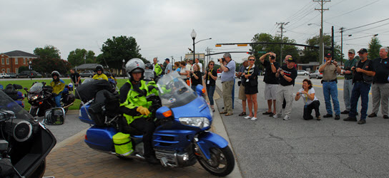
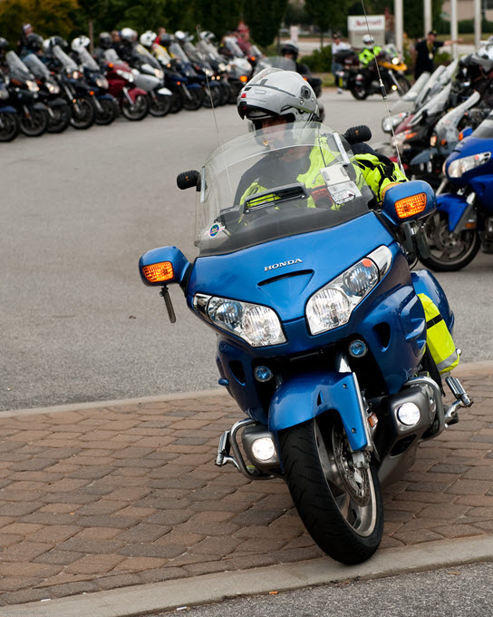
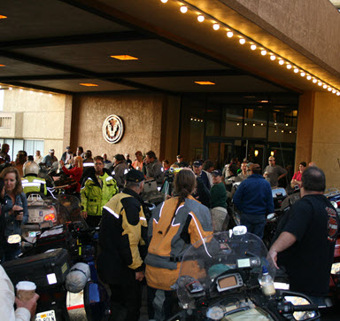
WHERE THIS COMES FROM
I learned most of this the hard way — on the clock
49,700
9th
2×
68,400
IRON BUTT RALLY MILES
2013 IRON BUTT RALLY
CAPE FEAR RALLY WINS
COMPETITIVE RALLY MILES
Sources: GregRice.com rally archive • 2009 IBR photo archive
Notes:
Real quick on where this comes from. I've got about 49,700 Iron Butt Rally miles and 68,400 competitive rally miles. I finished 9th in the 2013 IBR — the only touring bike in the top ten, on a Gold Wing, when most of the top ten were on FJRs. I won the Cape Fear Rally in 2012, and Rob and I won it again in 2015.
I'm not showing this to brag. I've also had a DNF in the 2017 IBR after sitting 4th after leg one, and in 2019 I threw away a top-ten finish at the scoring table — I'll tell you that story in a few minutes.
Everything in this talk came from wins, DNFs, bad weather, missed points and a lot of mistakes. I just wrote them down so you don't have to make them.

Slide 5
A REPEATABLE LOOP
How I approach every rally
COMMIT
Practice the process
ADAPT
PREPARE
Roll with it
Rider • bike • gear • tech
FINISH
SAFELY
EXECUTE
ORGANIZE
Ride • score • compare
Faster stops
PLAN
Time • bonuses • routes
Notes:
This is the whole talk on one picture. It's not plan, then ride, and you're done. It's a loop.
You commit and you practice. You get the rider, the bike and your tools ready. You get organized. You plan. You ride. Then something goes wrong — and you know it will — and you adjust and keep going.
And everything points to the middle: finish safely. It doesn't matter how many points you have if you don't make it to the finish, or you're time barred and a DNF.

Slide 6
NON-NEGOTIABLE
No bonus is worth getting hurt over
“If you are tired, the only option is to stop and rest.”
— Iron Butt Association safety guidance
NO SCORE IS WORTH IT
PLAN REST ON PURPOSE
FINISH WITH MARGIN
Tired, hurting, bad weather or riding sloppy? Those are reasons to stop — not something to “push through.”
I put the rest bonus and gas stops in my route as placeholders. If there's no rest in your route, it's broken.
The buffer is there for traffic, weather, wrong turns, slow roads — and for when you get tired.
Source: Iron Butt Association SaddleSore safety guidelines
Notes:
Before we talk about winning anything, let's get this out of the way. The IBA says it plainly: if you're tired, the only option is to stop and rest. Nobody fights off fatigue safely.
This isn't separate from competing. The riders who do well are the ones who manage themselves so they're still making good decisions and still riding well on day nine.
When I build a route, I put the rest bonus and gas stops in it as placeholders — even if I don't know exactly where I'll stop — so the time is already in the route. If your route only works if you never sleep, it's not a route.
One more thing I learned in 2009: push too hard in one leg and you'll have nothing left for the next one.

Slide 7
01
PREPARE BEFORE THE CLOCK
A lot of rallies are won or lost before you ever get the bonus pack. Get the rider, the bike and your tools ready.
Notes:
Section one is getting ready: being committed, doing your homework, knowing your own limits, and getting the motorcycle, gear and tools ready and organized.

Slide 8
THE DAY I SIGN UP IS THE DAY I START
Being committed
PRACTICE THE TOOLS
PRACTICE THE PROCESS
PRACTICE RECOVERY
I use my GPS's, Basecamp and my planner on every ride I do — not just rallies.
It's too late to learn your GPS the week before the rally.
Grab an old rally pack, set a deadline, then read it, format it, route it and load your GPS.
Then ride a short mock rally and score yourself honestly.
Break something on purpose: lose a GPS, close a road, delete a route, run 30 minutes late.
Practice getting back on plan — not just the perfect plan.
Notes:
The day I sign up for a rally is the day I start getting ready for it. I make a list of what the bike needs and what I need, and I put dates on it.
Being committed means you're committed to finishing, even when it gets tough — bad weather, road problems, feeling discouraged. And it means you're committed to learning your tools: your routing software, your maps, your camera and your GPS. If you don't know how to use your tools, your results won't be very good.
I use my GPS's and Basecamp on every ride I do, so when rally time comes it's all second nature. Don't buy a new laptop or GPS a week before the rally and expect to know how to use it.
And practice the whole thing — take an old rally pack, give yourself a deadline and go through it start to finish.

Slide 9
RESEARCH THE GAME
Do your homework on the rally
PAST BONUS PACKS
Not the bonuses — they always change. How does this RM build the bonus pack?
PRIOR WINNING ROUTES
Can you look at the old bonus list and come up with the route that won?
CHECKPOINT / FINISH WINDOWS
Know the leg times early. They set the shape of every leg.
SCORING CULTURE
What trips riders up at the scoring table? Photos? Receipts? Flags? Call-ins?
YOUR COMPETITIVE GOAL
Finish? Top 10? Win? Your goal decides how hard you should push.
Source: GregRice.com — Rally Planning
Notes:
After I sign up, I dig into past runnings of that rally. Most RMs hand out the bonus pack electronically these days, so old ones aren't hard to find. I also reach out to past riders for ideas.
I don't pay much attention to the actual bonuses — they always change. What I want is how the RM puts the bonus pack together. That's one less thing I have to figure out when the clock is running.
I'll also take the old bonus list and try to come up with the route that won. That's great practice.
And be honest about your goal. In 2019 my goal going in was just to be a finisher, because I was a DNF in 2017. That changes how hard you push.

Slide 10
PLAN THE RIDER YOU ACTUALLY ARE
Know your own numbers — and be honest
MOVING SPEED
FUEL RANGE
STOP FREQUENCY
Real average for this terrain
Comfortable, repeatable range
Fuel • food • hydration • bathroom
REST NEED
NIGHT TOLERANCE
WEATHER TOLERANCE
Planned sleep / off-bike recovery
How much night riding preserves performance?
Cold • heat • rain • wind
A route that depends on becoming a different rider after midnight is not a plan.
A conservative number you beat is better than a fast number you chase.
Notes:
Every route needs numbers about you: your moving average, how far you can go on a tank, how often you stop, how much rest you need, and how well you do at night and in bad weather.
Your moving average isn't the same everywhere. It's different out west than it is in the northeast, so I change it by leg.
Be honest here. The worst time to find out your moving average was a fantasy is halfway through the leg. A conservative number you beat is a lot better than a fast number you're chasing all day.

Slide 11
NO BIG CHANGES BEFORE THE START
Motorcycle readiness: boring is fast
I keep my bike in “ready to ride” mode — usually just tires and oil.
Old IBA proverb: don’t make big changes to the bike right before a rally.
Check it front to back: suspension, brakes, fuel system, lights, AUX tank.
Carry only tools and spares you know how to use.
Every farkle mounted solid and out of the way of riding the bike.
It’s not the motorcycle that drives you to the finish — it’s the rider. A reliable bike sure helps.
Source: GregRice.com — IBR preparation
Notes:
I try to keep my motorcycle set up the same way all the time, with all the farkles I'd use in the IBR. That way I know where everything is and how it works, and there's less stress. Usually before a rally I just need to check the tires and change the oil.
There's an old IBA proverb: don't make big changes to your motorcycle right before the start. Do your maintenance early enough that you can ride it afterwards and find out what you messed up.
I've ridden Gold Wings, a BMW RT and a GSA in the IBR. The first thing I'll tell you is it's not the motorcycle that drives you to the finish, it's the rider. But a good reliable bike sure helps. Checking it doesn't mean nothing will break — rallies are hard on bikes — but not checking is a good way to be a DNF.

Slide 12
KEEP RIDER PROBLEMS SMALL
Gear: broken in, simple, within reach
1
WEATHER
Gear you’ve ridden in — not gear with the tags still on.
2
VISIBILITY
Lighting / reflective gear that does not create new complexity.
3
HYDRATION
Drink while you ride; know where you’ll refill.
4
FOOD
Small, familiar, predictable. Avoid experiments under stress.
5
COMFORT
Seat, earplugs, gloves, boots, helmet liner — tested for hours.
6
ACCESS
Rain layer, glasses, meds, snacks and chargers where you can reach them quickly.
The less you have to stop and change gear or dig for something, the better.
Notes:
Good gear doesn't have to cost thousands of dollars, but it has to protect you from the weather. The less you have to stop and change gear because the weather changed, the better.
Don't buy new gear right before the rally. It won't be broken in, and you might find out too late it doesn't work for you.
Little things matter over 11 days. I wear a helmet liner so my head doesn't get hot and itchy — that sounds small, but it's the kind of thing that distracts you for hundreds of miles.
Every time you stop because you can't get to something, the clock keeps running. Over a multi-day rally those minutes add up.

Slide 13
KNOW YOUR TOOLS COLD
Laptop, GPS, camera and power
NAVIGATION
COMPUTER
CAPTURE
POWER
Test waypoint loads, which symbols show, rerouting without the laptop
Software installed and working, folders made, updates done before you leave
Camera/phone, rally flag, photo review, timestamps, storage, backup
Bike power, USB, laptop, battery packs, spare cables, labeled adapters
Practice it both ways: RM files → planner → Basecamp → GPS, and photo / receipt → scoring table.
Notes:
Make sure your laptop works and everything you plan to use is installed and working. Test loading waypoints from your mapping software into your GPS.
Check which waypoint symbols actually show up on your GPS. Unfortunately Garmin GPS's aren't all the same — some symbols work on one and not another.
Make sure your GPS can build a route on its own, because you're going to change your route on the road and you don't want to pull over and get the laptop out.
I keep my GPS's up to date with the latest maps and firmware — but I do it well before the rally, not in the hotel parking lot the morning of the start.

Slide 14
ASK “WHAT ENDS MY RALLY?”
Have a backup for anything that can end your rally
SINGLE POINT
FAILURE MODE
BACKUP / RECOVERY
NAVIGATION
Primary route display
Multiple GPS’s with ALL bonuses + routes loaded
POWER
One charging cable
Spare cable + second power path
RALLY FILES
One rally book / one laptop copy
Second copy (check with the RM first) + USB
BONUS EVIDENCE
One photo / unreadable receipt
Verify immediately; backup capture method
KEYS
One motorcycle key
Secure spare carried separately
FINISH ETA
Same device as bonus routing
Third GPS routed straight to the finish
Notes:
Ask yourself: what one thing could end my rally or cost me hours? Then have a backup for it.
I run multiple GPS's. One is routed to the bonus I'm headed to. The second is already routed to the next bonus, so when I pull in I'm not fumbling around and I don't take off in the wrong direction. The third one is for what-if planning, and on the last day it's routed to the finish so I always know how long it'll take to get there. And I use a male voice on one and a female voice on the other so I know which one is talking.
I make two copies of the rally book when the RM allows it. One is my scratch pad during the rally. When my writing isn't readable — which is usual — or it gets wet, I copy it over to the clean one before I go to the scoring table.
And keep a backup key on the bike.

Slide 15
EVERYTHING HAS A HOME
Being organized is free time on the clock
Same item • same pocket • every time
FLAG / CAMERA
WALLET / RECEIPTS
ZERO
FUMBLING
CHARGERS
SNACKS / WATER
TOOLS / SPARES
PAPER / PEN
Notes:
Being organized makes you efficient, which means faster bonus stops, which means more time to ride and score more bonuses.
It can be as simple as keeping your camera, flag, pens and flashlight in the same place every time so you never have to hunt for them. Lay out everything you plan to carry before the rally and find a good spot for each thing.
Do this on your normal rides too. Then it's just habit, and if something isn't where it belongs, you notice right away.

Slide 16
STAGE THE WORKSPACE
The “Sunday before the IBR” checklist
RIDER + BIKE STAGING
COMPUTER + ROUTING STAGING
✓
Clothes / gear laid out
✓
Laptop powered + network verified
✓
Wallet / cash / cards
✓
Rally folders already created
✓
Hydration ready
✓
Email / download workflow tested
✓
Keys + backup key on bike
✓
Planner / spreadsheets open
✓
Snacks / water
✓
Basecamp open, old data cleared
✓
Camera / phone / flag
✓
Leg 1 route started: start → checkpoint
Source: GregRice.com — pre-rally checklist
Notes:
This is my actual checklist for the Sunday before the IBR, before we get the bonus list at the start banquet.
Riding clothes laid out for Monday. Wallet and cards in my riding clothes, emergency money stashed on the bike. Wake-up call and alarm set. Hydration system clean. Keys ready with the backup key on the bike.
On the computer side: a desk and chair set up to plan routes, note pad and pencils, water and snacks. GPS's cleaned out. Cables tested. Computer on the hotel network, email tested. My spreadsheet or planner open. Basecamp open with the old stuff removed. And my leg 1 route already started — start hotel to the first checkpoint hotel.
Everything you can do before you get the bonus pack is more time to read and think once you have it.

Slide 17
02
DECODE THE RALLY BOOK
Reading comprehension is the most important thing you do. Read the whole rally book before you route.
Notes:
Section two is how I read the rally book — very carefully — and how I get all the bonuses into a format I can actually plan with.

Slide 18
DON’T START ROUTING YET
Read the entire rally book before routing
RULES
Scoring / penalties / required evidence
REQUIRED
Checkpoints • rest • call-ins • mandatory bonuses
WINDOWS
Daylight • timed • opening / closing
COMBOS
Sets, strings, themes, multipliers
ROUTE
Only now: build the road plan
The rally book decides your route. Don’t route until you’ve read all of it.
Source: GregRice.com — “How I Read The Rally Pack”
Notes:
The first thing I do when I get the rally book is make sure it's complete. At the IBR start banquet the RM tells you to check that you have every page, and I've had problems with both printed and electronic versions over the years. If I get a flash drive, I copy the files to a folder I already made and open them to make sure they're not corrupted.
Then I read the whole thing before I plan anything. I'm looking for combos, the rest bonus, group photos, timed bonuses, call-ins — anything that changes how you plan.
I number every bonus, including the wild cards and the non-riding ones like the fuel log. A good-looking route you built before you found the combo or the rest rule is just a fast way to waste your planning time.

Slide 19
MY MOST EXPENSIVE MISTAKE
One poker chip cost me 19,000 points
19,000
2019 IBR, Isle of Capri Casino: five photos with my flag — but I never bought the poker chip the rally book asked for. Top 10 to 40th.
POINTS LOST
STOP BEFORE YOU SHOOT
At every bonus, read the requirement again — photo, receipt, token, whatever — before you ride off.
Source: GregRice.com — 2019 IBR lesson
Notes:
Here's the one that still hurts. 2019 Iron Butt Rally. I was 9th after leg one. On leg three I went for the Mississippi River combo — ten bonuses for about 19,000 extra points. I got all ten, picked up some more on the way back, and even went for Linville Falls on the Blue Ridge Parkway, sat in a dark parking lot at 2 in the morning with the bears waiting for daylight. I felt great.
I get to the scoring table. We get to the Isle of Capri Casino bonus and I'm feeling good — I took about five photos and my flag was in every one of them. The scorer asks, "Where's your poker chip?" I'm like, what are you talking about? They show me the rally book, and sure enough, I was supposed to buy a poker chip too.
Lost the bonus, lost the combo, lost 19,000 points, and went from the top ten to 40th. I was not a happy camper. In all my rallies before that I had never lost a bonus at the scoring table.
Two lessons: read the whole rally book when you plan, and read the bonus again when you get there. Thinking you know what it says is exactly what gets you.

Slide 20
MAKE THE PUZZLE SORTABLE
Get every bonus into one list you can sort
CODE
POINTS
AVAILABILITY
WINDOW
ABC
423
Daylight
Sunrise–sunset
COMBO
LAT / LON
REQUIREMENT
NOTES
MISS1
Exact coordinates
Photo + flag
Access / parking / clue
Once it’s in a list, you can toss what you can’t reach, spot the patterns and rebuild a route fast.
Notes:
Once I understand the rules, I get every bonus into my spreadsheet — now my web planner — with the code, points, availability, time window, combo, coordinates, what I need to score it, and any notes, like "big bat on the wall."
The rally master's files usually give you the code, the lat/lon and the points. The part that takes time is going through the rally book and figuring out the availability for each bonus — daylight only, timed, anytime. That's the most time-consuming part, and it's the part you can't skip.
Watch out: in past IBRs the bonus location file and the points file haven't matched one for one. Call-ins, rest and combos were in one and not the other. Always check your counts.

Slide 21
CODE • POINTS • AVAILABILITY
My bonus name tells me what I need to know on the GPS
ABC
—
423
—
D
BONUS CODE
POINT VALUE
AVAILABILITY
A
Anytime
D
Daylight
T
Timed
AC
Anytime combo
DC
Daylight combo
TC
Timed combo
G
Group photo
H
Checkpoint
S
Special
Source: GregRice.com — sample naming convention
Notes:
This is my bonus naming convention: code, points, availability. ABC-423-D. I looked at how the big dogs were naming bonuses back in 2005 and made a few changes of my own.
A is anytime, D is daylight only, T is timed, and if it's part of a combo I add a C — AC, DC, TC. G is a group photo, H is a checkpoint, and S is a special bonus — one you know the RM really wants you to go to.
For timed bonuses I add the window using the 24-hour clock so I don't have to mess with AM and PM, like ABD-1200-T-18-20.
Why go to all this trouble? When I'm riding and want to add or drop a bonus, I can see on the GPS what it's worth and whether I can even get it. I do not want to plan a route that has me showing up at a daylight-only bonus in the middle of the night.

Slide 22
SHAPE = AVAILABILITY • COLOR = VALUE
Symbols and colors: see the big rocks at a glance
AVAILABILITY
24-HOUR
DAYLIGHT
TIMED / SPECIAL
POINT VALUE
≤ 1,000
1,001–2,500
HIGH VALUE
VERY HIGH
Zoom out in Basecamp and the big rocks, daylight-only and timed bonuses should jump right out.
Source: GregRice.com — waypoint symbol method
Notes:
I use the shape of the symbol for availability and the color for points. Circles for 24-hour bonuses, squares for daylight only, triangles or flags for timed and special bonuses.
For color, I usually use green for the low bonuses, blue for the middle, red for the big ones and purple for the really big ones. I stick with about three ranges — more than that just makes it harder for me. And I adjust the ranges for each rally, because every rally's points are different.
When you zoom out in Basecamp, the red ones — the big rocks — jump right out. That's where I start.

Slide 23
JUDGE THE SET — NOT THE SINGLE WAYPOINT
Combo bonuses change the math
1668
680
889
2537
604
466
1412
591
211
9438
10-bonus 2019 IBR combination
18,799
4,172
22,971
MISS COMBO 1
MISS COMBO 2
COMBO VALUE
That 211-point bonus was the Isle of Capri — the one I blew. Small bonus, huge combo.
Source: GregRice.com — 2019 IBR combo example
Notes:
Combos throw simple thinking out the window. Here's the 2019 Mississippi combo — ten bonuses. Some of them are only a few hundred points. If CAPRI-211 wasn't part of a combo, I probably wouldn't have had it in my route at all.
But score all ten and you get 22,971 combo points across the two MISS combos.
And yes — that 211-point bonus is the Isle of Capri. The poker chip one. The smallest bonus in the set is the one that cost me the whole thing.
So tag your combo bonuses before you start routing. My planner puts the combo name right on the bonus so it shows up in the GPS, and you can pull up just the bonuses in that combo.

Slide 24
03
BUILD A ROUTE YOU CAN EXECUTE
Start with the clock, plan around the big rocks, build your routes and protect the finish.
Notes:
Section three is building the route: figuring out your hours, range rings, planning around the big rocks, building more than one route, ETAs and making sure you get to the finish.

Slide 25
HOW MANY HOURS CAN I REALLY RIDE?
Start with time — not distance
RIDING HOURS = LEG CLOCK − REQUIRED REST − FUEL / FOOD − BONUS STOPS − CHECKPOINT TASKS − SAFETY BUFFER
CLOCK
REST
FUEL
BONUS
BUFFER
Riding hours × a moving average for that part of the country = about how many miles to plan.
RANGE RINGS
CORRIDOR THINKING
Draw range rings in Basecamp. Bonus outside the ring? Skip it.
Look for a fairly straight line from the start to the checkpoint or finish.
Source: GregRice.com — Hours & Miles / range-ring planning
Notes:
My spreadsheet started with one simple question: how many hours can I actually ride? I take the leg hours and subtract all the known reasons I'll be stopped — rest, gas, food, bonus stops, checkpoint — and that's my riding hours. Then I multiply by a moving average for that part of the country, and that tells me about how many miles I should plan.
Range rings are a great quick trick. In Basecamp, create a waypoint and put a distance in the Proximity field, and it draws a ring on the map. I draw them before I ever show up at the start, since we usually know the leg times ahead of time.
Example: if I have 30 hours of riding and I can ride about 1,800 miles, and the leg is an out-and-back, then anything outside the 900-mile ring I just ignore. No reason to route to a bonus you can't get to and still make it back without getting time barred.

Slide 26
LOOK FOR STRUCTURE BEFORE DETAIL
Find the “big rocks” — then connect them efficiently
FINISH
1 SEE THE PATTERN
Where are the high-value clusters, combos and natural corridors?
2 CONNECT BIG ROCKS
Plan around the big point bonuses, then add what’s on the way.
3 CHECK THE CLOCK
START
Every route has to pass the clock: rest, gas stops, finish time.
Notes:
First I just look at the map and all the bonuses and see if a pattern jumps out with the big point bonuses. I also look for a fairly straight line from the start to the checkpoint or finish. In leg 2 of the 2013 IBR that's pretty much what it was.
I plan around the big rocks first, then look at what smaller bonuses I'm riding right past and add those.
If you start by collecting every little bonus that looks good, you end up with a route that's real busy and doesn't score much.

Slide 27
GIVE YOUR FUTURE SELF OPTIONS
I plan aggressive — then build my outs
WEATHER / FIRE ROUTE
Routes around storms, snow, hurricanes or fires
Built before the start so you can switch fast when it hits.
LESS AGGRESSIVE
The one I build after I come to my senses
Fewer fragile timed stops and more room to the checkpoint.
AGGRESSIVE
More bonuses than I can really ride — on purpose
It’s a lot easier to drop bonuses on the fly than to add them.
Load ALL the bonuses and ALL the routes into EVERY GPS. Stopping to boot up the laptop will cost you.
Source: GregRice.com — Rallying / My Route Planning
Notes:
I always plan an aggressive route — more bonuses than I can really ride in the time I have. That's on purpose, because it's a lot easier to drop bonuses on the fly than it is to add them. So there's a good chance I'll be dropping bonuses as I ride.
Then I build more routes depending on the rally: one around bad weather — snow or hurricanes, and yes, it does happen — and in a couple of rallies there were fires in Florida and California, so I built routes depending on how bad the fires got. And usually one that's a little less aggressive, once I come to my senses.
Yes, building multiple routes slows me down when I'm planning on the clock. But when I'm done I load all the bonuses and all the routes into all my GPS's. In one rally I only loaded the bonuses in the area I planned to ride, then had to make big changes — and I had to stop and hook the GPS up to the laptop to load everything. Cost me a lot of time. If you keep stopping for different reasons, you're not going to do well.

Slide 28
A ROUTE IS A TIMETABLE
Schedule every bonus — then watch the variance
PLAN ETA
STOP
LEG / GAP
ACTUAL VS PLAN
07:00
START
0:00
—
09:05
ABC-423-D
2:05
+0:05
11:20
JDC-1200-DC
2:15
+0:10
13:10
FUEL / FOOD
1:50
−0:05
15:45
XYZ-2500-T
2:35
+0:20
18:30
DROP DECISION
2:45
+0:35
22:00
REST
3:30
+0:20
06:30
FINISH ETA
—
BUFFER 1:30
Decide now: “If I’m an hour behind here, what’s the first bonus I drop?”
Notes:
Basecamp gives me an arrival time at every bonus. I write my route on index cards — the bonuses and the time I should get to each one — and keep them in a map pocket, with a second copy in the trunk.
Then as I ride, I check how I'm doing. Ahead of schedule? I can add a bonus. Behind? I start looking at what I can drop without losing too many points. That's where the naming convention and the symbol colors really pay off.
The important part: decide ahead of time. If I'm 30 minutes or an hour late at this bonus, what's the first one I drop? Make that decision at the desk, not at 2 in the morning.
Another nice thing about having the route in the GPS: it can't get wet or lost. I've seen plenty of riders lose their route list or get it so wet they couldn't read it.

Slide 29
DON’T GET TIME BARRED
The finish is the one bonus you can’t miss
FINISH CLOSES
NO NEW OPTIONAL BONUS
NOW
LAST OPTIONAL
BUFFER START
FINISH
INDEPENDENT ETA
BUFFER IS REAL
TIME BAR = ZERO
On the last day I route one GPS straight to the finish so I always know my time.
Don’t keep spending it because “traffic looks good.”
Time barred = DNF. A late big route loses to an on-time smaller one.
Notes:
I think of the checkpoint and the finish as the one bonus you absolutely can't miss. Keep a real buffer and keep it where you can see it.
On the last day of a rally I use my third GPS to route to the finish, so no matter what bonus I'm headed to, I know how long it'll take me to get to the finish. In 2019 I rolled into the finish about 10 minutes before the penalty window started. That's closer than I'd recommend.
And don't keep spending the buffer just because the last hour went well. The buffer is for the problem you haven't hit yet.

Slide 30
OPTIMIZE WHAT THE CLOCK MEASURES
Points per mile is useful — points per elapsed hour is better
A
2,500 pts
80 mi
1h 35m road + 10m stop
1,429 pts/hr
B
4,000 pts
155 mi
2h 55m road + 20m stop
1,231 pts/hr
C
1,700 pts
35 mi
0h 42m road + 8m stop
2,040 pts/hr
Illustrative example — road type, bonus-stop time, timing windows, combos and risk can matter more than raw miles.
Notes:
Points per mile is good for a quick look, and my planner calculates it. But the clock doesn't measure miles, it measures time.
A short bonus with a tough stop — parking, walking, finding the thing — can be worse than it looks. A longer bonus that's all interstate might be better. And a small bonus might be a must-have because it's part of a combo.
These numbers are just an example. The point is to look at the whole time it costs you, not just the road miles.

Slide 31
2013 SPREADSHEET → 2026 WEB PLANNER
The tools changed. The process didn’t.
2013
Spreadsheet workflow
2026
Web-based Rally Bonus Planner
Import / enter bonuses
Format code • points • availability
Calculate sunrise / sunset
Export GPX to Basecamp / GPS
Build multiple routes manually
Import GPX • KML • CSV • Excel • PDF
Auto address • timezone • sun • weather
Map by value and availability
Route / export GPX and XLSX
AI suggested route to get you started
AUTOMATE THE MECHANICS
It does the grunt work. You still read the rally book, manage your rest and decide when to stop.
Source: GregRice.com Rally Bonus Planner help
Notes:
I started my rally spreadsheet back in 2013 to get me into routing faster. Hundreds of rally riders have used it over the years, including a lot of top-ten IBR finishers. Copying the bonus data in took about 5 minutes and saved over an hour of typing in Basecamp.
My new web-based Rally Bonus Planner replaces the spreadsheet. It imports the RM's files, looks up the address, time zone, sunrise, sunset and weather, and plots everything on a map by points and availability. Then you export a GPX for Basecamp and your GPS, or an Excel file.
But here's my warning: it doesn't read the rally book for you. AI can suggest a route, but it doesn't know you're tired, that the road is worse than it looks, or that you missed a line in the bonus instructions. That part is still on you.

Slide 32
RALLY BONUS PLANNER — FROM RAW FILE TO USABLE ROUTE
A modern planning pipeline
1
2
3
4
5
IMPORT
ENRICH
VISUALIZE
ROUTE
EXPORT
GPX • KML • CSV • TSV • TXT • Excel • PDF
Address • timezone • sunrise / sunset • weather
Point-value colors • availability shapes • combo tags
Manual scenarios • optimize order • AI suggested route
GPX to navigation • XLSX for analysis / backup
Heads up: the AI Suggested Route only picks from the bonuses you give it. You still check required bonuses, daylight/timed windows, rest, gas and the finish.
Source: Rally Bonus Planner Help — current September 2026
Notes:
Here's how the planner works, start to finish. Import the files — GPX, KML, CSV, Excel, even PDF. It fills in the address, time zone, sunrise, sunset and weather. It maps everything by point value and availability, with combo tags. You build your routes. Then export a GPX to your GPS or Basecamp, or an Excel file as a backup.
The GPX puts the sunrise, sunset and your comments on the bonus so you can see them right on the GPS. Newer Garmins don't show the comment field anymore, so I put that information in fields they do show. That's real handy for daylight-only bonuses.
The AI Suggested Route is a helper, not the rider. You still check everything.
[If time allows: quick live demo in the planner.]

Slide 33
04
EXECUTE & ADAPT
A great route is just a plan. Points come from doing a lot of little things right while everything keeps changing.
Notes:
Section four is riding it: sticking to the plan, bonus stops, what to do when things go wrong, and a few drills you can practice.

Slide 34
PLAN → ACTUAL → DECISION
Ride the plan — and keep checking your times
PLAN
ACTUAL
VARIANCE
DECIDE
ETA 15:45
ETA 16:05
+20 min
Drop / keep / reroute
You expect
You observe
You quantify
You act
Don’t wait until you’re way behind. Ten minutes late is easy to fix. Ninety minutes late forces ugly choices.
Notes:
Once the rally starts, I try to ride my planned route and keep track of my schedule. That keeps me moving, and it doesn't give me much time to have negative thoughts about how I'm doing. A positive, confident mindset really helps in a long rally.
Your route is a guess. Keep comparing where you are to where you planned to be. Ten minutes late, you have options. Ignore it until you're ninety minutes late and your options may be gone.
On long rides between bonuses I use my extra GPS to play what-if — what happens if I add this one, or drop that one.

Slide 35
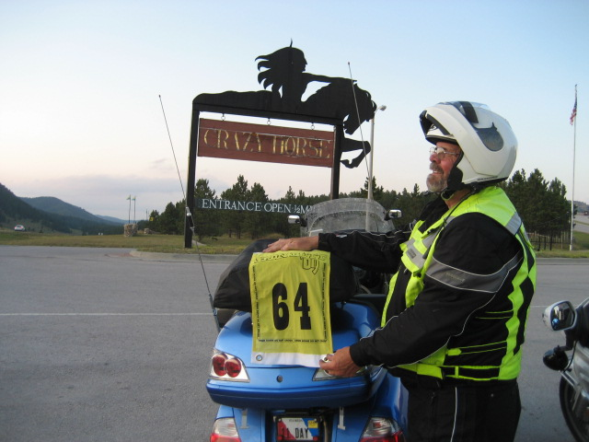
FAST COMES FROM DOING IT THE SAME WAY
Do every bonus stop the same way
1
2
3
4
5
6
PARK
READ
SET
CAPTURE
VERIFY
LOG + GO
Safe • legal • easy exit
Reread exact requirement
Flag / bike / object positioned
Take required photo / receipt
Zoom in — can scoring see it?
Write it down, stow it, next bonus up
The costly stop isn’t the 90-second one. It’s the one you have to redo — or the one that scores zero.
Notes:
I want every bonus stop to be the same. Park safe. Read the bonus again. Get the flag where it needs to be — I carry clips, cord and clothespins to hang my flag. Take the photo or get the receipt. Check it. Write it down, put it away, and the next bonus is already loaded on my other GPS.
Now, confession time. One of my biggest problems in a rally is I like to talk. I've spent 30 minutes at a bonus hanging out with other riders as they pulled in. In the 2012 Cape Fear Rally I decided I wasn't going to take my helmet and jacket off at bonus stops. Shorter stops, and it's a lot harder to talk to people. I won that rally.
Just don't save time by skipping the check. Remember the poker chip.

Slide 36
WEATHER • TRAFFIC • CLOSURE • MECHANICAL • FATIGUE
Something will go wrong — you know it will
1 STABILIZE
2 RECOMPUTE
3 SIMPLIFY
4 COMMIT
Get safe. Stop moving if the problem requires attention. Do not troubleshoot while mentally overloaded.
What time remains? What requirements remain? What is the new finish ETA?
Drop fragile / low-efficiency work. Preserve required items and margin.
Pick the new route and quit mourning the old one.
Sunk miles and missed bonuses are history. The only question that matters: “What’s the best safe move from here?”
Notes:
Something will go wrong. When it does, first get safe. If you need to stop, stop. Don't try to figure it out while you're rattled and riding.
Then figure out where you really are: how much time is left, what you still have to do, what your new finish time is.
In 2019 I needed a rear tire on leg three. A good friend, Bob Torter, helped me find a shop in Bozeman, Montana, and they had me in and out in 30 minutes while I was on the clock. That's what being ready to adapt looks like.
The trap is trying to get back to the old plan. That time is gone. Simplify, pick the new route and go.

Slide 37
MOST ARE PREVENTABLE
Five ways I’ve seen riders lose a rally
ROUTING BEFORE READING
You optimize the wrong game.
1
FANTASY SCHEDULE
Moving average and stop times assume your best day all day, everyday.
2
UNFAMILIAR TECH
You learn your GPS during the rally.
3
STOP-TIME CREEP
Every “quick” stop turns into 15–30 minutes.
4
NO FINISH BUFFER
A small delay turns into a time bar.
5
Notes:
These are the ones I see over and over, and I've done most of them myself.
Routing before you read the whole book. A schedule that assumes your best day, all day. Learning your GPS during the rally. Stop-time creep — and trust me, a 5-minute stop turns into 30 real fast if you like to talk like I do. And no buffer to the finish.
The good news is every one of these is something you can control. That's really the whole reason to have a process.

Slide 38
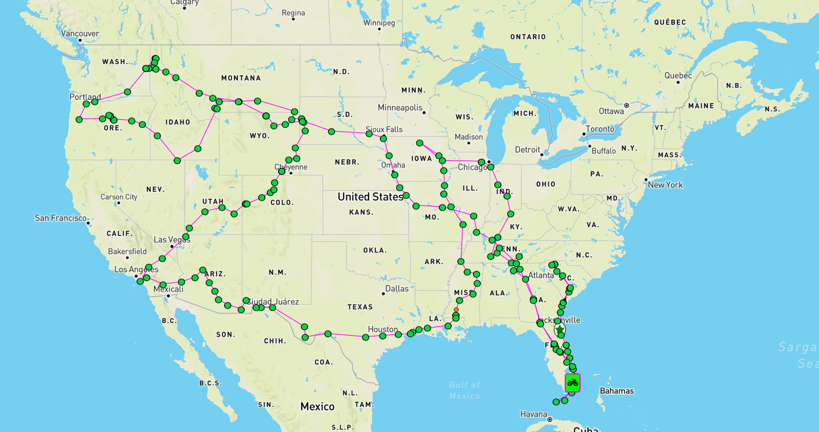
11 DAYS • 10,962 OFFICIAL RALLY MILES • FIRST IBR FINISH
My first IBR: the route never looks like the plan
WHAT THE MAP TEACHES
Solve the leg you’re on — don’t try to solve all 11 days.
Weather and closures can wipe out a good plan fast.
Build routes that are easy to shorten and still make the checkpoint.
Push too hard in one leg and you’ll have nothing left for the next.
35th • 92,614 pts • Silver
Source: Greg Rice 2009 IBR archive / official results supplied by Greg Rice
Notes:
This is my whole 2009 IBR route — my first Iron Butt Rally, and wow, what a rally, what a ride. What you see here is what I actually rode, not the nice clean line I planned before each leg. I had to make a lot of changes, especially on leg 2.
The IBR and the 2010 IB5000 were a real eye-opener for me. I saw the commitment and determination it takes. And I learned not to push so hard in one leg that you have nothing left for the next.
You don't have to solve all 11 days on day one. Solve the leg you're on, and don't do anything that keeps you from finishing.
When you ride into the finish of an IBR you say to yourself, I'm never doing that again. By the end of the banquet that night you're already thinking about applying for the next one.

Slide 39
FOUR DRILLS BEFORE YOUR NEXT RALLY
Practice the skills separately — then combine them
20-MINUTE ROUTE
BONUS-STOP DRILL
Take an old bonus pack. Give yourself 20 minutes to read, format and choose a route.
Set up 5 fake bonuses. Practice park → read → capture → verify → log → leave.
FAILURE DRILL
6-HOUR MOCK RALLY
Mid-route, “lose” a GPS, close a road or remove a planned bonus. Rebuild fast.
Ride a short event with real ETAs, rest/fuel plan and scoring. Debrief where time leaked.
You don’t get better at rallying by thinking about it. You get better by practicing it.
Notes:
Here are four things you can practice before your next rally.
Take an old bonus pack and give yourself 20 minutes to read it and pick a route. Set up five fake bonuses and practice your bonus stop. On a practice ride, pretend your GPS died or a road is closed and rebuild. And ride a short mock rally with real ETAs, gas and rest.
After every rally — practice or real — ask yourself: where did I lose time? What confused me? What did I carry and never use? What did I wish was somewhere I could reach?

Slide 40
THE WHOLE SEMINAR ON ONE SLIDE
If you forget everything else, remember these
1
READ THE WHOLE BOOK
before you route.
2
PLAN THE RIDER YOU ARE
not the rider you hope to be at 2 a.m.
3
START WITH TIME
then convert realistic hours into distance.
4
MAKE THE MAP VISUAL
so the big rocks and daylight bonuses jump out.
5
PLAN AGGRESSIVE
it’s easier to drop bonuses than add them.
6
PROTECT THE FINISH
with a real buffer and independent ETA.
7
ADAPT WITHOUT EMOTION
the next decision is the only one you can change.
Notes:
If you only remember seven things from today, make it these.
Read the whole book before you route. Plan for the rider you are, not the rider you hope to be at 2 in the morning. Start with time. Make the map easy to read. Plan aggressive and drop bonuses as you go. Protect the finish. And when things go wrong, don't dwell on it — make the next good decision.
The tools will keep changing. This stuff doesn't.

Slide 41
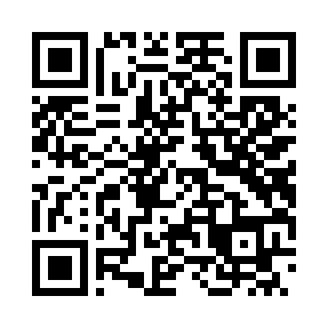
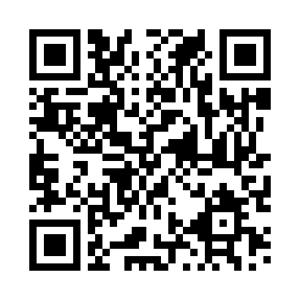
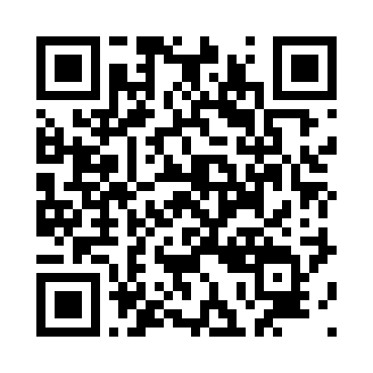
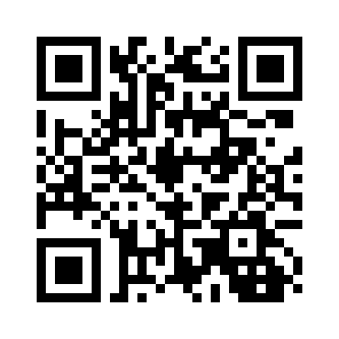
SCAN NOW — USE LATER
Resources to keep learning
RALLY PLANNING
RALLY BONUS PLANNER HELP
2021 RALLY PLANNING SEMINAR
MY IBR PREPARATION
gregrice.com/rallys/rallys.html
gregrice.com/rally-planner/help.html
YouTube • 3-hour deep dive
gregrice.com/ibr/ibr.html
I keep updating all of these. If you have questions, reach out — greg@gregrice.com
Notes:
Here's where you can find all of this. My rallying page has everything I talked about today and more. The help page for the Rally Bonus Planner has a demo video. There's the 3-hour online seminar I did in 2021 if you really want to dig in. And my IBR page has all my past Iron Butt Rallies with the Spotwalla maps.
I keep updating these, so check back. And if you have questions, send me an email — I'm always glad to help riders get into this sport.

Slide 42
QUESTIONS?
Plan the rally.
Ride the plan.
Get home safe.
Greg Rice • gregrice.com
Thank you to the Iron Butt Association and the Big As Texas organizers.
Notes:
That's it. Plan the rally, ride the plan, and get home safe.
If you take one thing home: being prepared and organized is what makes the difference when something goes wrong — and you know it will.
Thanks again to the Iron Butt Association and the Big As Texas folks. What questions do you have?
[If time allows: quick demo of the Rally Bonus Planner.]

