Slide 1
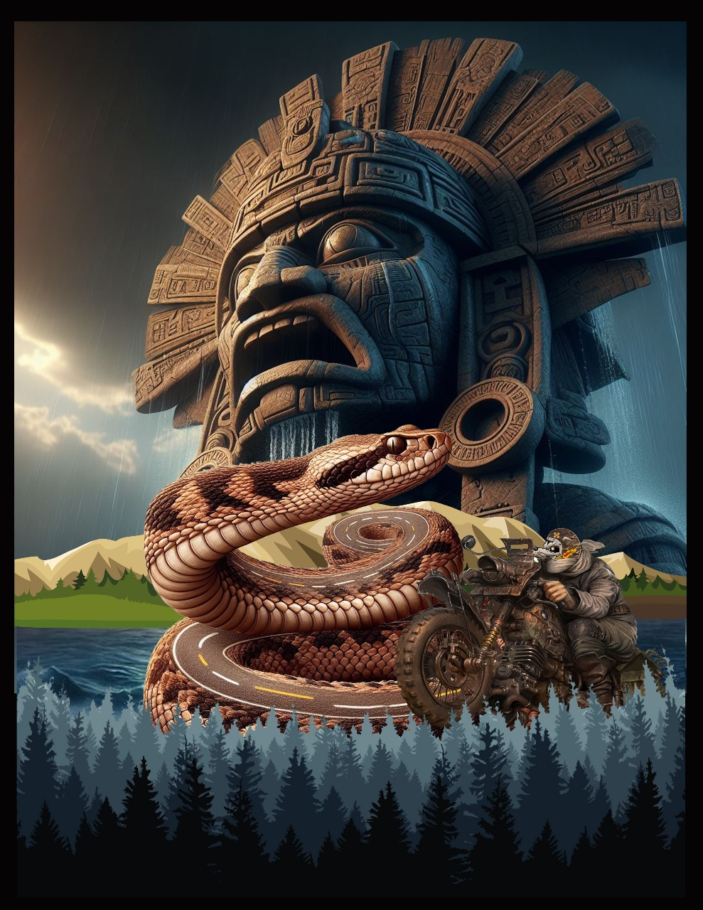
Big Adventures On Two Wheels: Riding South Of The Border - Mexico

Slide 2
Introduction About Me
Here is a short background on me and how I got into riding motorcycles long distance.
My father was a Shriner and road Harley Davidson Electra Glide’s for the motor corps, and I attended a lot of the Shriner parades over the years. I got to ride along some times during those years. Once I graduated high school in 1974, I joined the Navy I bought my first motorcycle after boot camp, a Honda 500. I really could not afford a car on a E-3 salary back then, but the motorcycle really pulled me in. I started riding from Great Lakes Naval Base to Miami, a nice 1,300 mile ride each way, and I was hooked on long distance riding ever since. I found it very cool to be able to ride so far and especially with just a few dollars in my pocket. I did a lot of long distance riding in the late 1970’s. I bought a Kawasaki KZ-650 in 1978, and I rode 40,000 miles that year and as far as to the Grand Canyon.
After becoming disabled and leaving the Navy I became a police officer and continued my riding. I eventually went to work for a government agency and moved to Japan where my motorcycle riding really took off. After returning to the US in 1986 I continued riding many different types of motorcycles until I got married and started having children. For about 10 years I did not ride much as I was busy with my two boys. At the end of 1998 I bought a Kawasaki Nomad 1200 and started riding again while living in northern New Jersey.
We moved back to south Florida in 2002, and I started hearing about the Iron Butt Association and I knew I needed a different motorcycle to start riding IBA rides, so I traded my Nomad for a 2003 Honda Gold Wing and have not looked back since. In 2016 I switched to riding BMW’s and have owned two RT’s and four GSA’s riding over 264,000 miles on those BMW’s.
I have ridden over 900,000 miles since 1974 and ridden in 12 countries. I have completed 125 IBA rides with 95 of those being BBG’s ( 1500+ miles in less than 24 hours ) and with many of them being back to back. I have ridden in 5 Iron Butt Rallies and finishing in the top 10 in 2013 on a Gold Wing. I have written a few magazine articles, and I have a pretty informative website, and I have also developed software that helps riders in long distance endurance rallies like the IBR.
Big Adventures On Two Wheels: Riding South Of The Border - Mexico

Slide 3
Overview Of How I Ride Long Distance Endurance Rides
I approach long distance endurance riding very seriously, some would say too serious, but I want to get where I am headed, and I want to get back home safely. I am a planner and preparer, that is what I do for work, so I find it easy to plan and prepare for long rides.
I usually do a lot of research of my destination and the route to get there. I like to know the route in my mind just in case.
I do a walk through of the ride many nights before going to sleep just be sure I know what I am planning and where I am headed.
I prepare my motorcycle which includes checking all the systems multiple times, things like breaks, lights and connectivity. I also do a full service and new tires. I do my own service so I can do the service a few days before I head out.
I try and prepare my body for endurance and the ability to stay alert for long hours.
I carry the gear to get me back on the road in the event something happens.
Big Adventures On Two Wheels: Riding South Of The Border - Mexico

Slide 4
Preparing Your Motorcycle (Maintenance, Spare Parts)
To me this is very important, and I take getting my motorcycle ready to ride seriously. A lot of this is what we all do normally, it's just that you need to be sure your motorcycle is in great condition for a ride like this as there may not be any help in proximity and especially if you plan on riding at night.
I do a full maintenance on my motorcycle and depending on how many miles are on the clock I may do valve checks, grease the driveshaft spline and other maintenance that would be required based on how many miles I have on the motorcycle.
I do my own maintenance so it is a little easier for me and saves me a lot of money so I can do rides like these.
Change oil & filter because I will not be changing the oil again until I get back home.
Change the final drive gear lube.
Mount new front and rear tires.
Carry Multiple Types Of Tire Repair Kits
Two Air Compressors
Tire Spoons ( 3 ) - Be able to remove tire on the road
Tools
Duct Tape
Zip Ties
Jump Start Battery
Siphon Hose
Tow Rope - In case someone needs to be towed
Extra Fuel ( I have an AUX Tank )
Big Adventures On Two Wheels: Riding South Of The Border - Mexico

Slide 5
What To Carry - Packing List (Gear, Tools, Essentials)
I carry a lot of items with me and for many of those items I carry a backup, I way over plan and always carry more than is really needed.
Hydration System For Drinking Water
Extra Water
First Aid Kit ( Including Israeli Bandages, Sams Splint, Tourniquet )
Flashlights ( 6 )
Backup Portable Chargers - To Charge Cell Phone And Or Headset
Backup Cell Phone
SPOT X Two Way Satellite Messages - TWO-WAY Satellite Messenger
SPOT GEN 4 Satellite Messages - Satellite tracking
Waterproof Camping Tent / Tarp
Sleeping Pad
Personal Cleaning Items
Toilet Paper
Wet Ones
Big Adventures On Two Wheels: Riding South Of The Border - Mexico

Slide 6


IBA Mexico – Asphalt Rats
Big Adventures On Two Wheels: Riding South Of The Border - Mexico

Slide 7

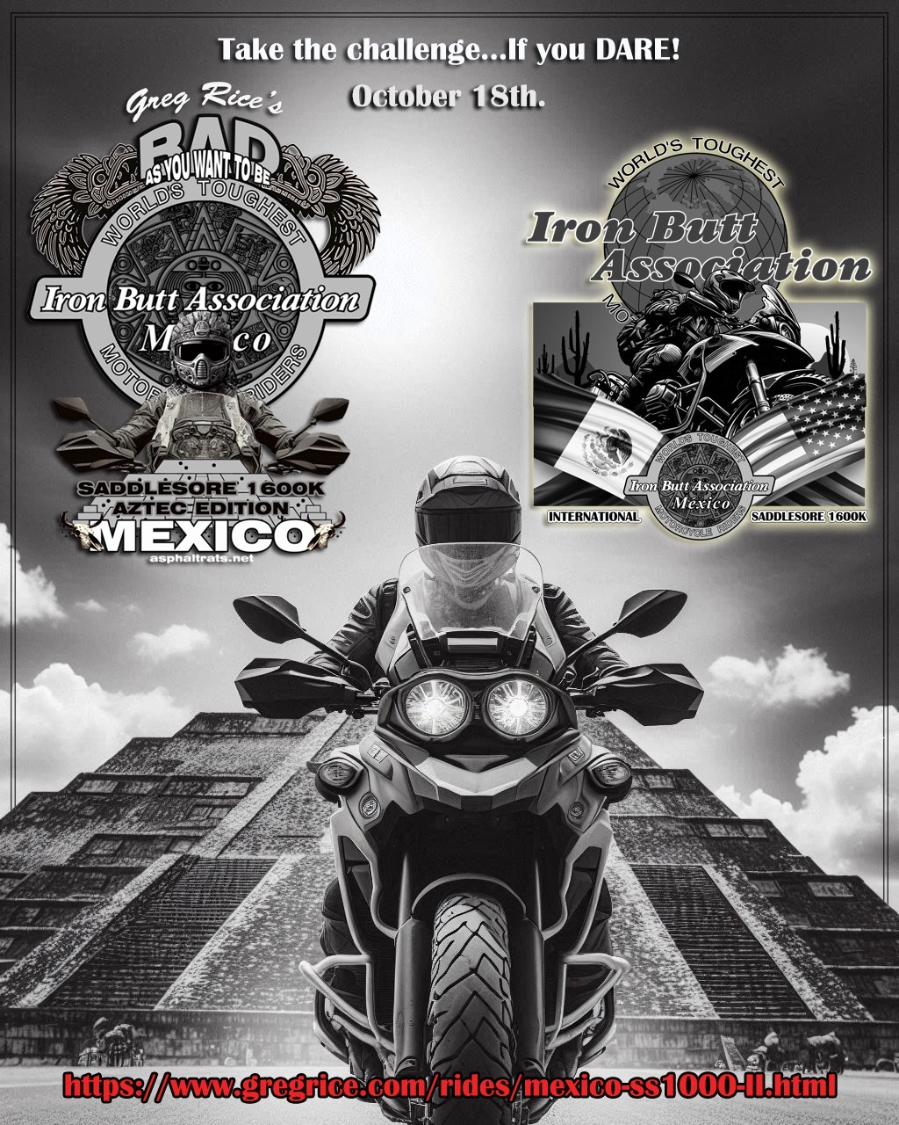
Big Adventures On Two Wheels: Riding South Of The Border - Mexico

Slide 8
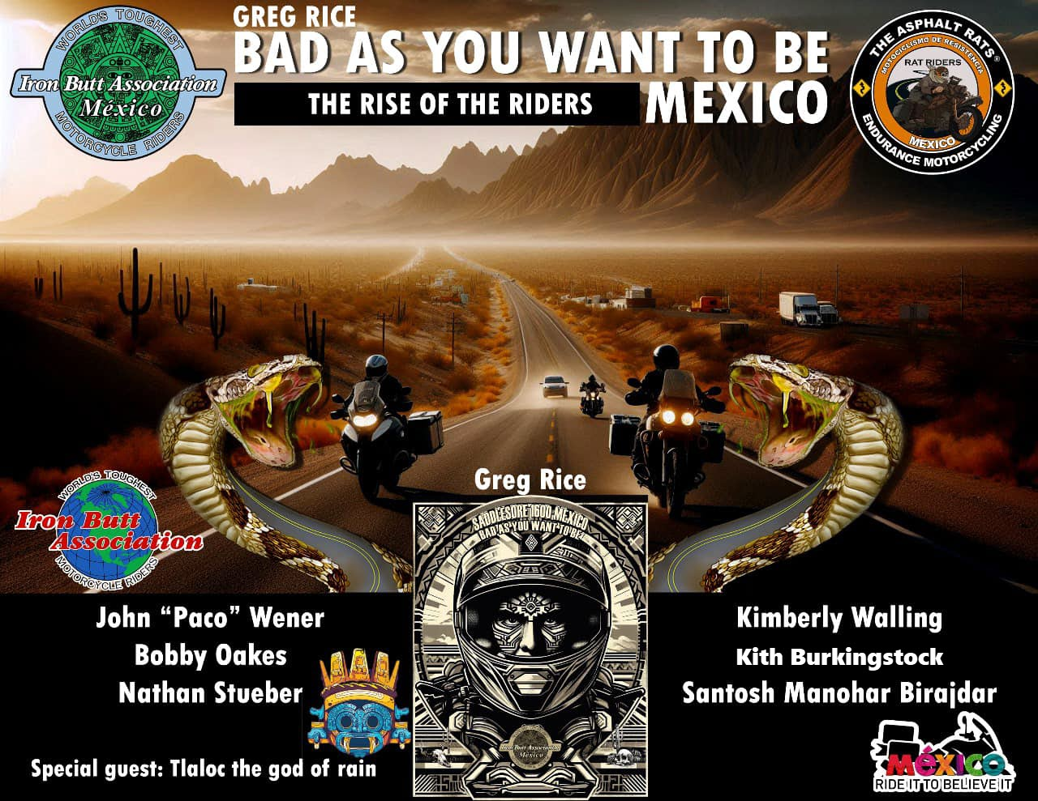
Big Adventures On Two Wheels: Riding South Of The Border - Mexico

Slide 9

Big Adventures On Two Wheels: Riding South Of The Border - Mexico

Slide 10

Big Adventures On Two Wheels: Riding South Of The Border - Mexico

Slide 11

Big Adventures On Two Wheels: Riding South Of The Border - Mexico

Slide 12
Rides I Have Done South Of The Border
Big Adventures On Two Wheels: Riding South Of The Border - Mexico

Slide 13
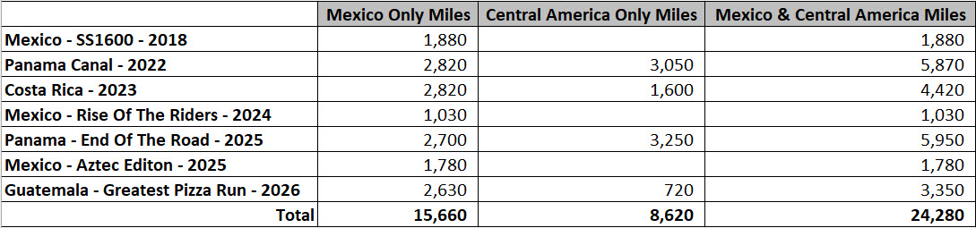
My Riding South Of The Border
I have crossed the border into Mexico 9 times over the years, and I have ridden 24,280 miles and 41 border crossings between my Mexico and Central America rides. This includes a ride to the end of the road at Yaviza, Panama in March of 2025. Since 2022 I have ridden 3 times to Central America and twice all the way to Panama and two other times to Mexico and back. It has been a great experience and other than a flat I had in Guatemala on the first ride to Panama Canal I have not had any issues. My friend Mike Bobbitt has ridden 16,000+ of these miles with me and it was great having someone like Mike along for the ride. I have a lot of information, photos and videos that I have put together that helped us do these rides. I also have many photos and videos of the border crossings and what is needed to enter each country. This information could help you plan a ride south to Mexico and Central America and make the process a little easier.
Big Adventures On Two Wheels: Riding South Of The Border - Mexico

Slide 14
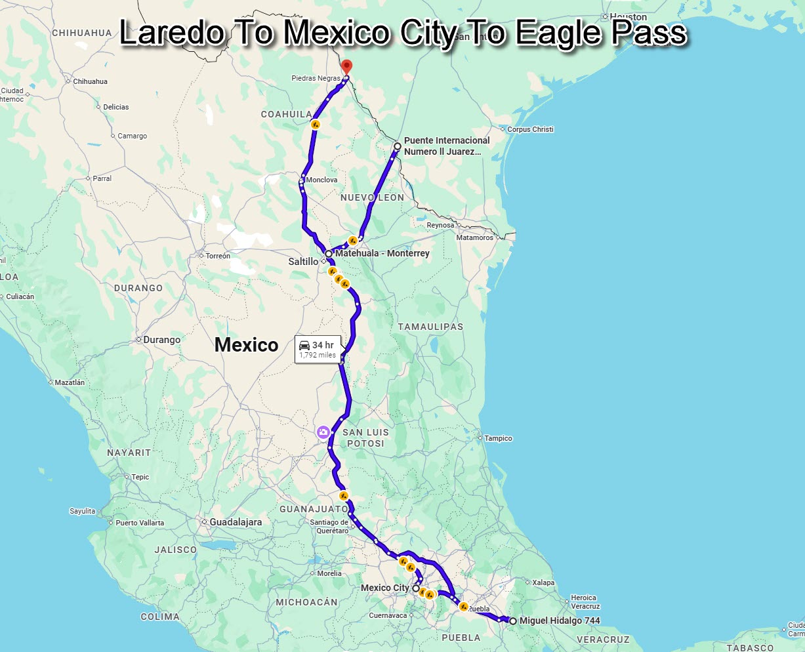
2018
Done!
Big Adventures On Two Wheels: Riding South Of The Border - Mexico

Slide 15
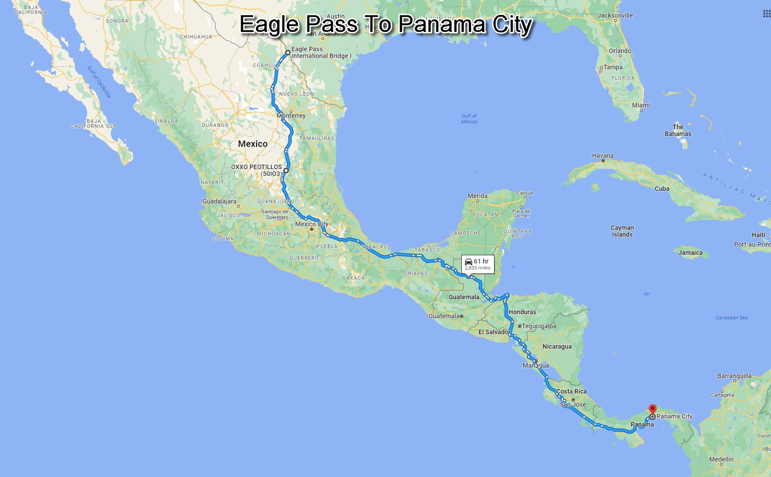
2022
Done!
Big Adventures On Two Wheels: Riding South Of The Border - Mexico

Slide 16
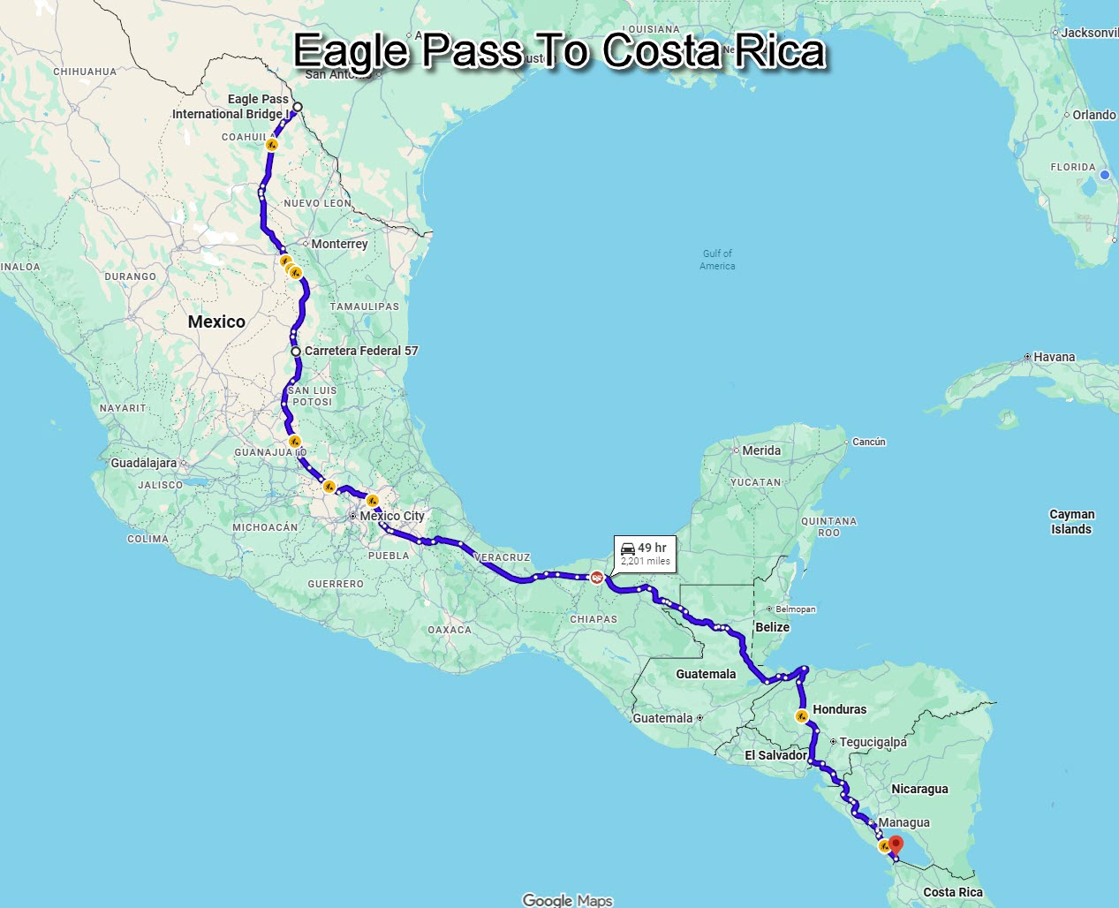
2023
Done!
Big Adventures On Two Wheels: Riding South Of The Border - Mexico

Slide 17
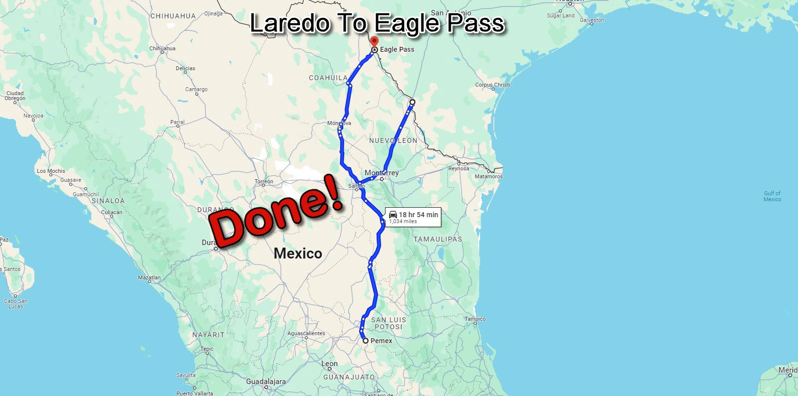
2024
Big Adventures On Two Wheels: Riding South Of The Border - Mexico

Slide 18
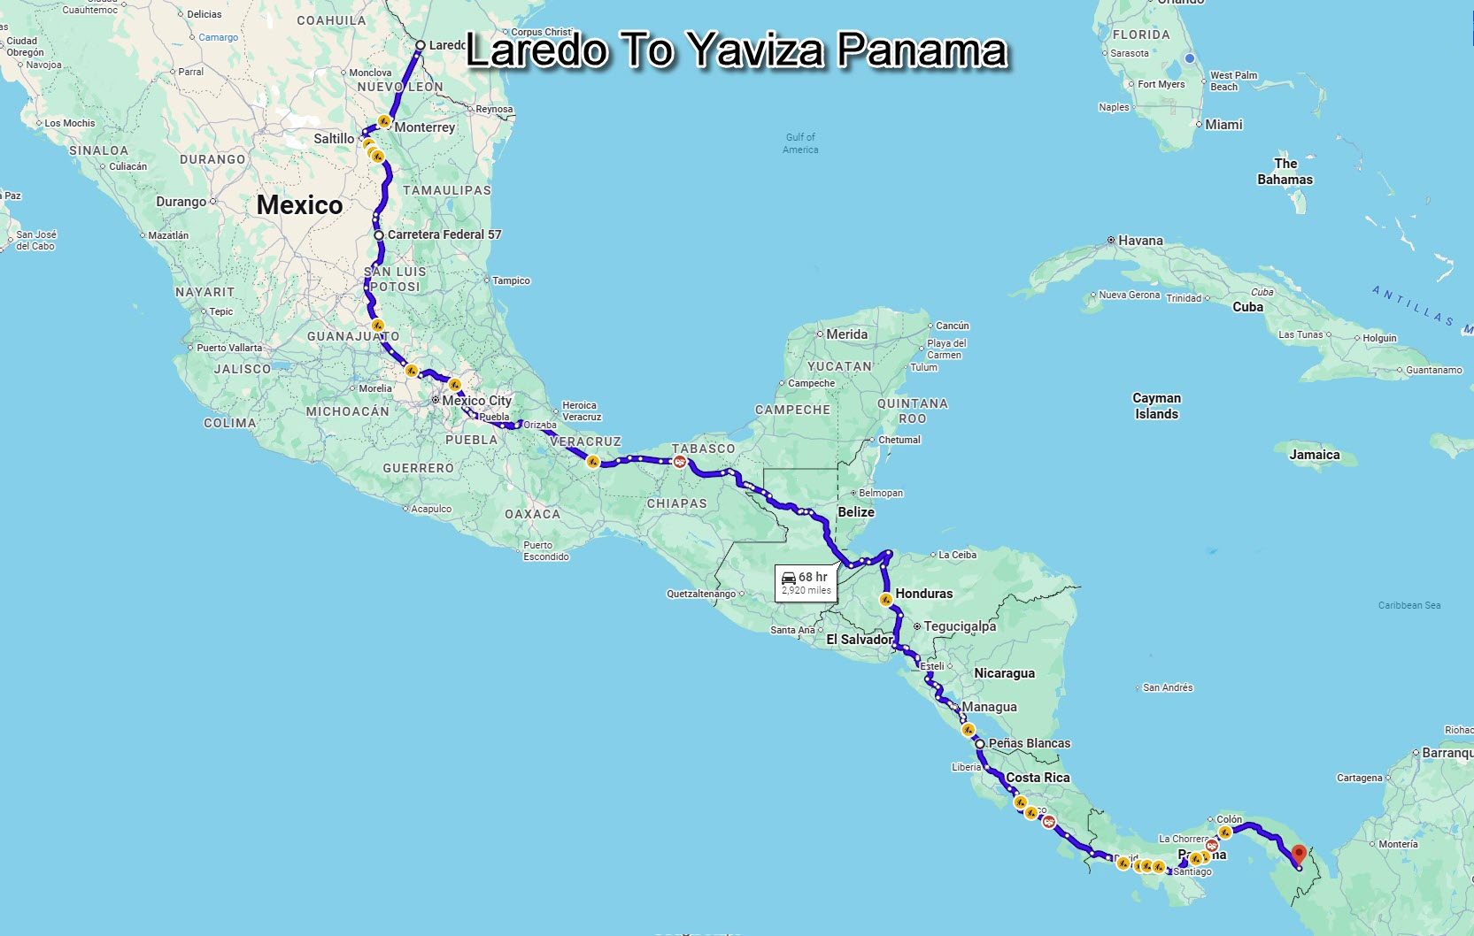
2025
Done!
Big Adventures On Two Wheels: Riding South Of The Border - Mexico

Slide 19
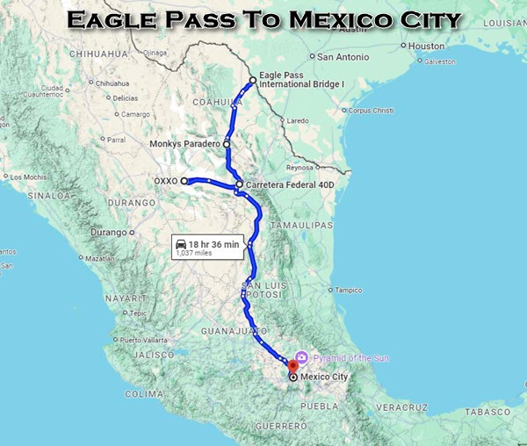
2025
Done!
Big Adventures On Two Wheels: Riding South Of The Border - Mexico

Slide 20
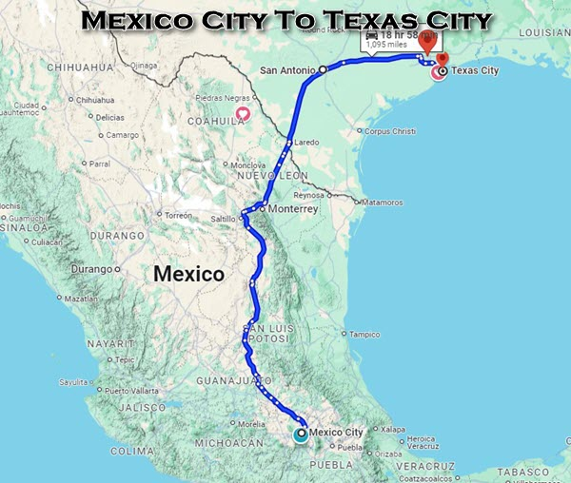
2025
Done!
Big Adventures On Two Wheels: Riding South Of The Border - Mexico

Slide 21
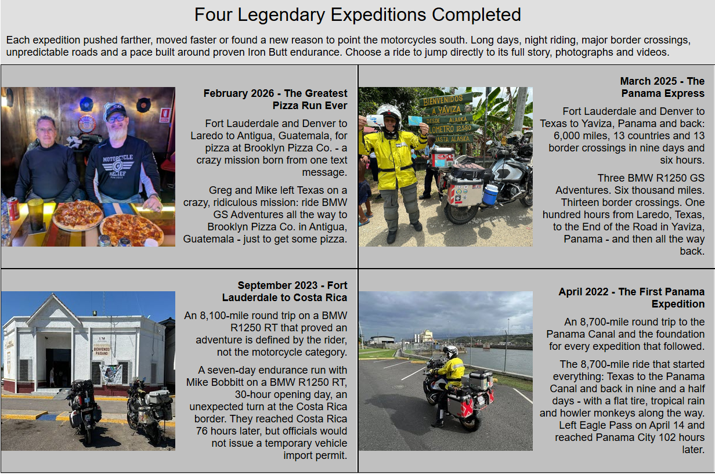
Big Adventures On Two Wheels: Riding South Of The Border - Mexico

Slide 22

Big Adventures On Two Wheels: Riding South Of The Border - Mexico

Slide 23
Big Adventures On Two Wheels: Riding South Of The Border - Mexico

Slide 24
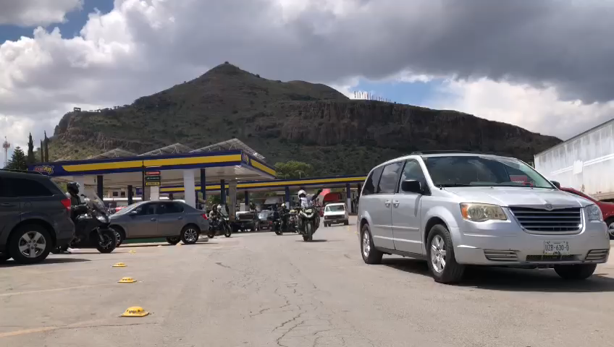
Big Adventures On Two Wheels: Riding South Of The Border - Mexico

Slide 25
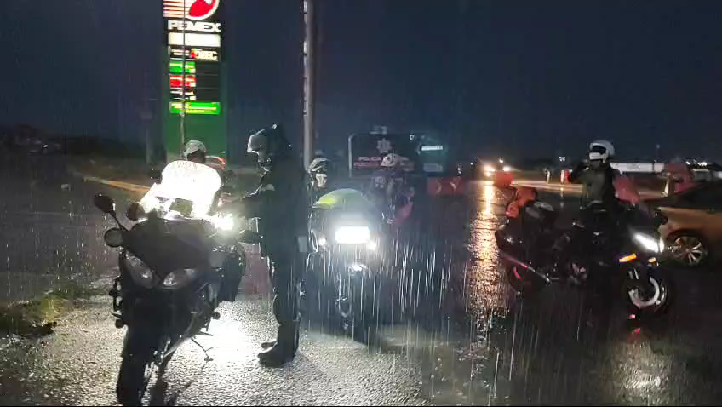
Big Adventures On Two Wheels: Riding South Of The Border - Mexico

Slide 26
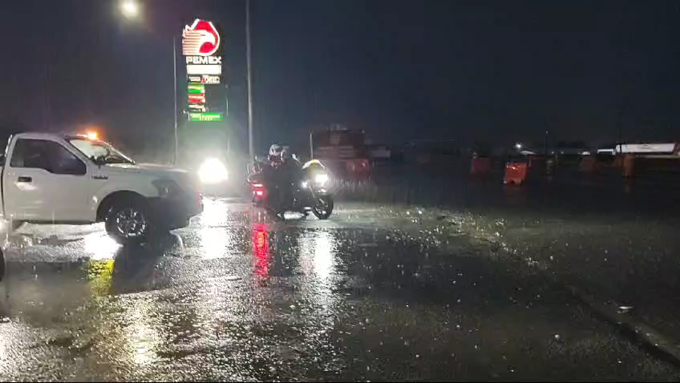
Big Adventures On Two Wheels: Riding South Of The Border - Mexico

Slide 27
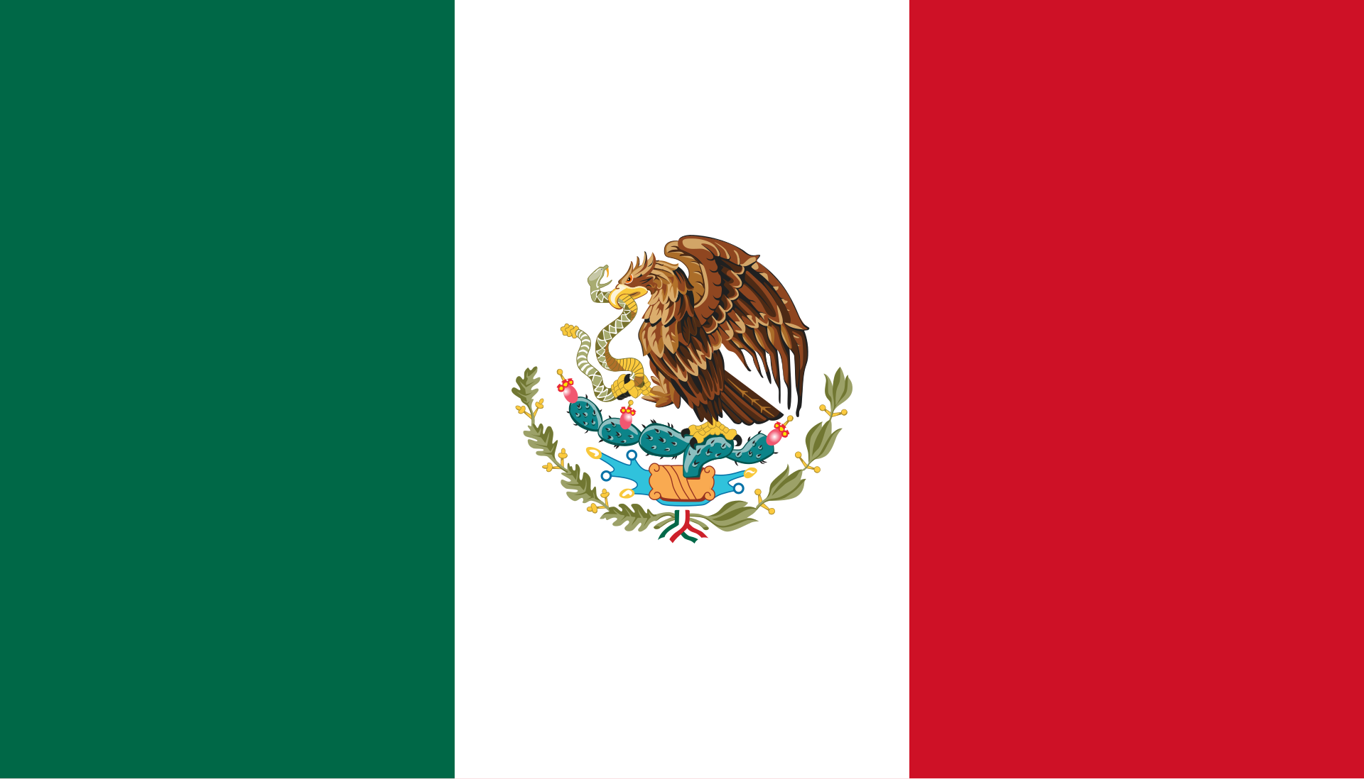
Mexico
Don’t Go Not Prepared
Big Adventures On Two Wheels: Riding South Of The Border - Mexico

Slide 28
Minimum Required To Enter Mexico
Passport - Valid For More Than 6 Months Minimum
Drivers License
Vehicle Registration and or Vehicle Title In Your Name
The Leasing / Loan Contract - if you're leasing our have a loan on the car with a letter saying you have permission to drive to Mexico
Temporary Vehicle Import Permit ( TIP ) - Obtained Prior Or At The Border
Tourist Card - Obtained Prior Or At The Border
Vehicle Insurance - Obtained Prior Or At The Border
Big Adventures On Two Wheels: Riding South Of The Border - Mexico

Slide 29
Riding In Mexico
Riding in Mexico can be very interesting, and you must learn to go with the flow. It took as a few miles of riding in Mexico to get in the grove and once we were comfortable.
Mexico border crossings at the immigration and Banjército office.
Most of the roads I have ridden in Mexico were in good condition and some of the toll roads were equivalent to US interstates.
Speed limit signs in Mexico are for decoration as no one pays attention to them. We passed police cars at speed.
Cars, trucks and busses pass everywhere even on two lane roads so you need to be alert as the next thing you may see is an 18-wheeler coming at you in your lane.
On our route there was a lot of tollbooths, so you must be ready to pay the tolls. We had a plan where one of us would pull up to the tollbooth and pay the toll for both of us. We kept Mexican currency in our jacket vest pocket easy to get to.
There was a LOT of gas stations along our entire route, and most were open 24 hours. More gas stations than anything else.
There were many services plazas along the toll roads and plenty of places to get food like Subway, Burger King and others.
There are a lot of topes ( speedbumps ) in Mexico off the main highways so keep and eye out for them. In some locations Waze will notify you of upcoming topes.
Big Adventures On Two Wheels: Riding South Of The Border - Mexico

Slide 30
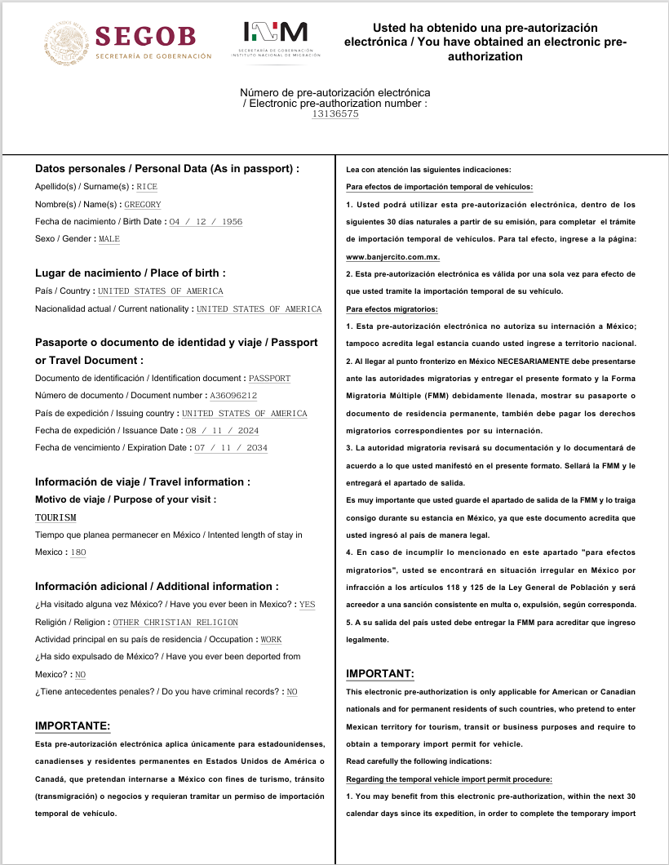
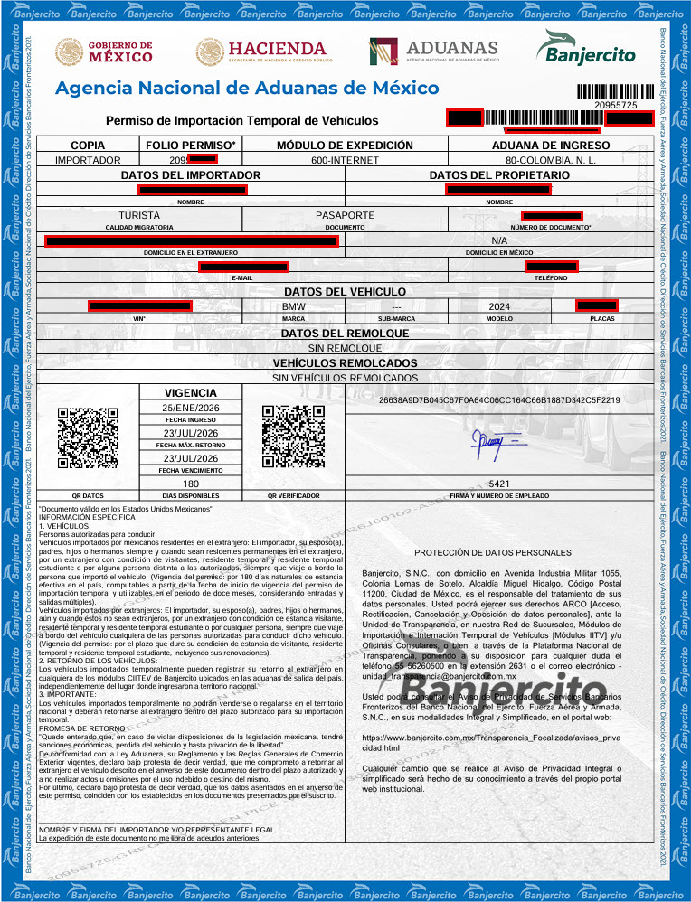
Obtaining Temporary Vehicle Import Permit ( TIP )
Big Adventures On Two Wheels: Riding South Of The Border - Mexico

Slide 31
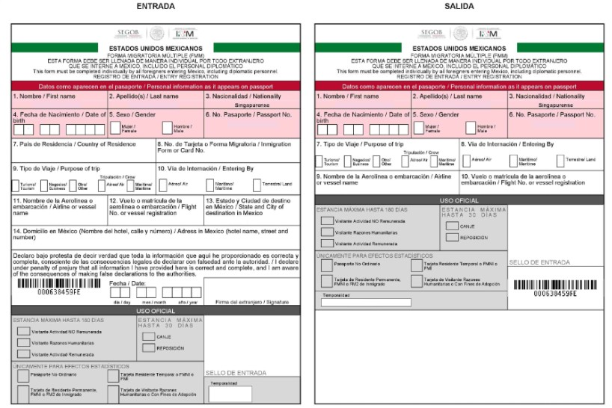
Obtaining Mexico Tourist Visa ( FMM )
Big Adventures On Two Wheels: Riding South Of The Border - Mexico

Slide 32
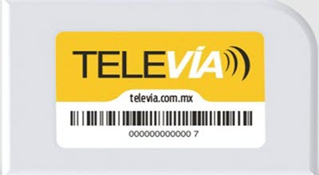
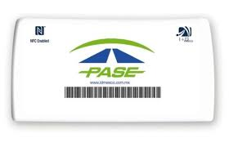
Mexico Toll Transponders
Big Adventures On Two Wheels: Riding South Of The Border - Mexico

Slide 33
Some Of The IBA Certificates I Have Received Riding South Of The Border
Big Adventures On Two Wheels: Riding South Of The Border - Mexico

Slide 34
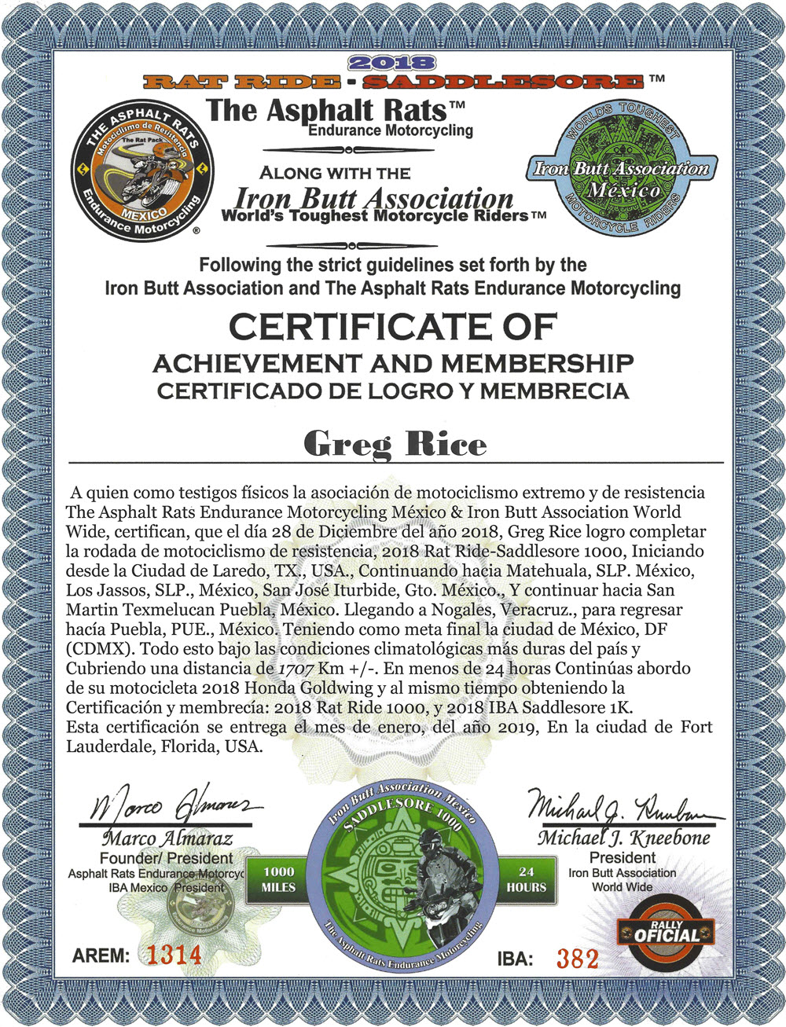
Big Adventures On Two Wheels: Riding South Of The Border - Mexico

Slide 35
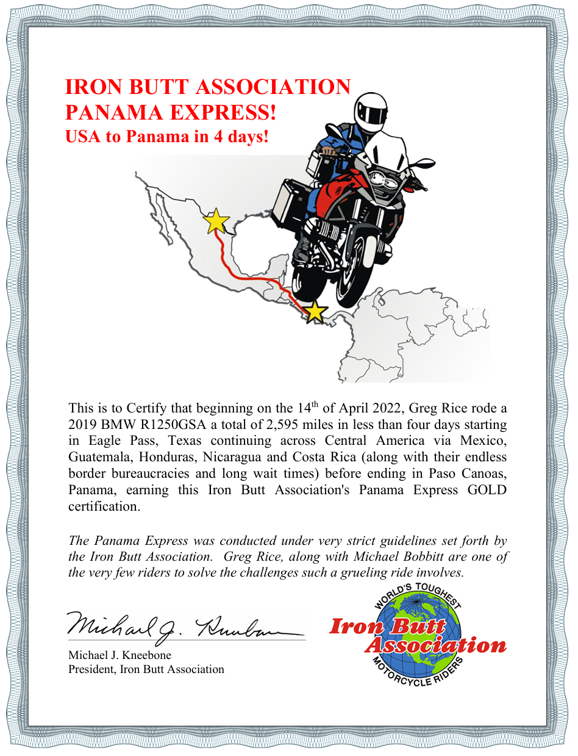
Big Adventures On Two Wheels: Riding South Of The Border - Mexico

Slide 36
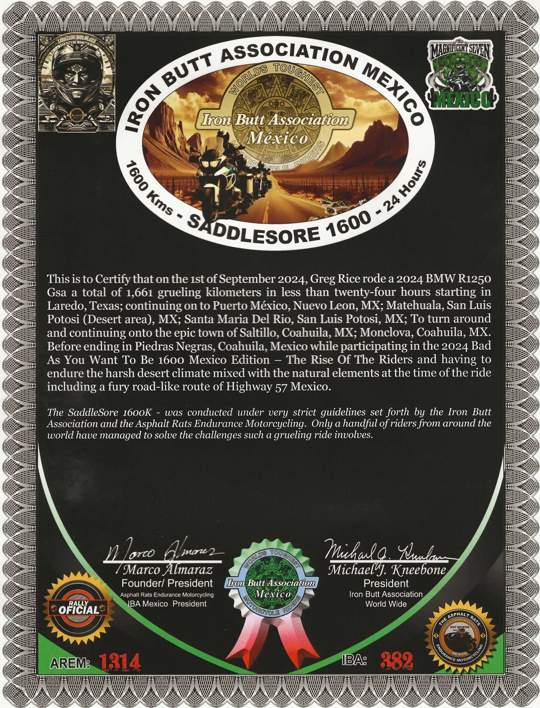
Big Adventures On Two Wheels: Riding South Of The Border - Mexico

Slide 37
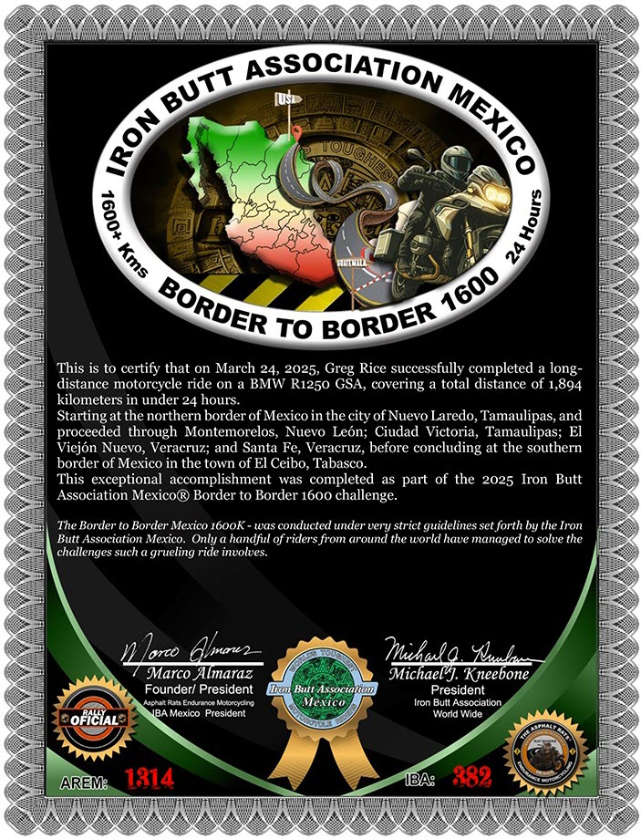
Big Adventures On Two Wheels: Riding South Of The Border - Mexico

Slide 38
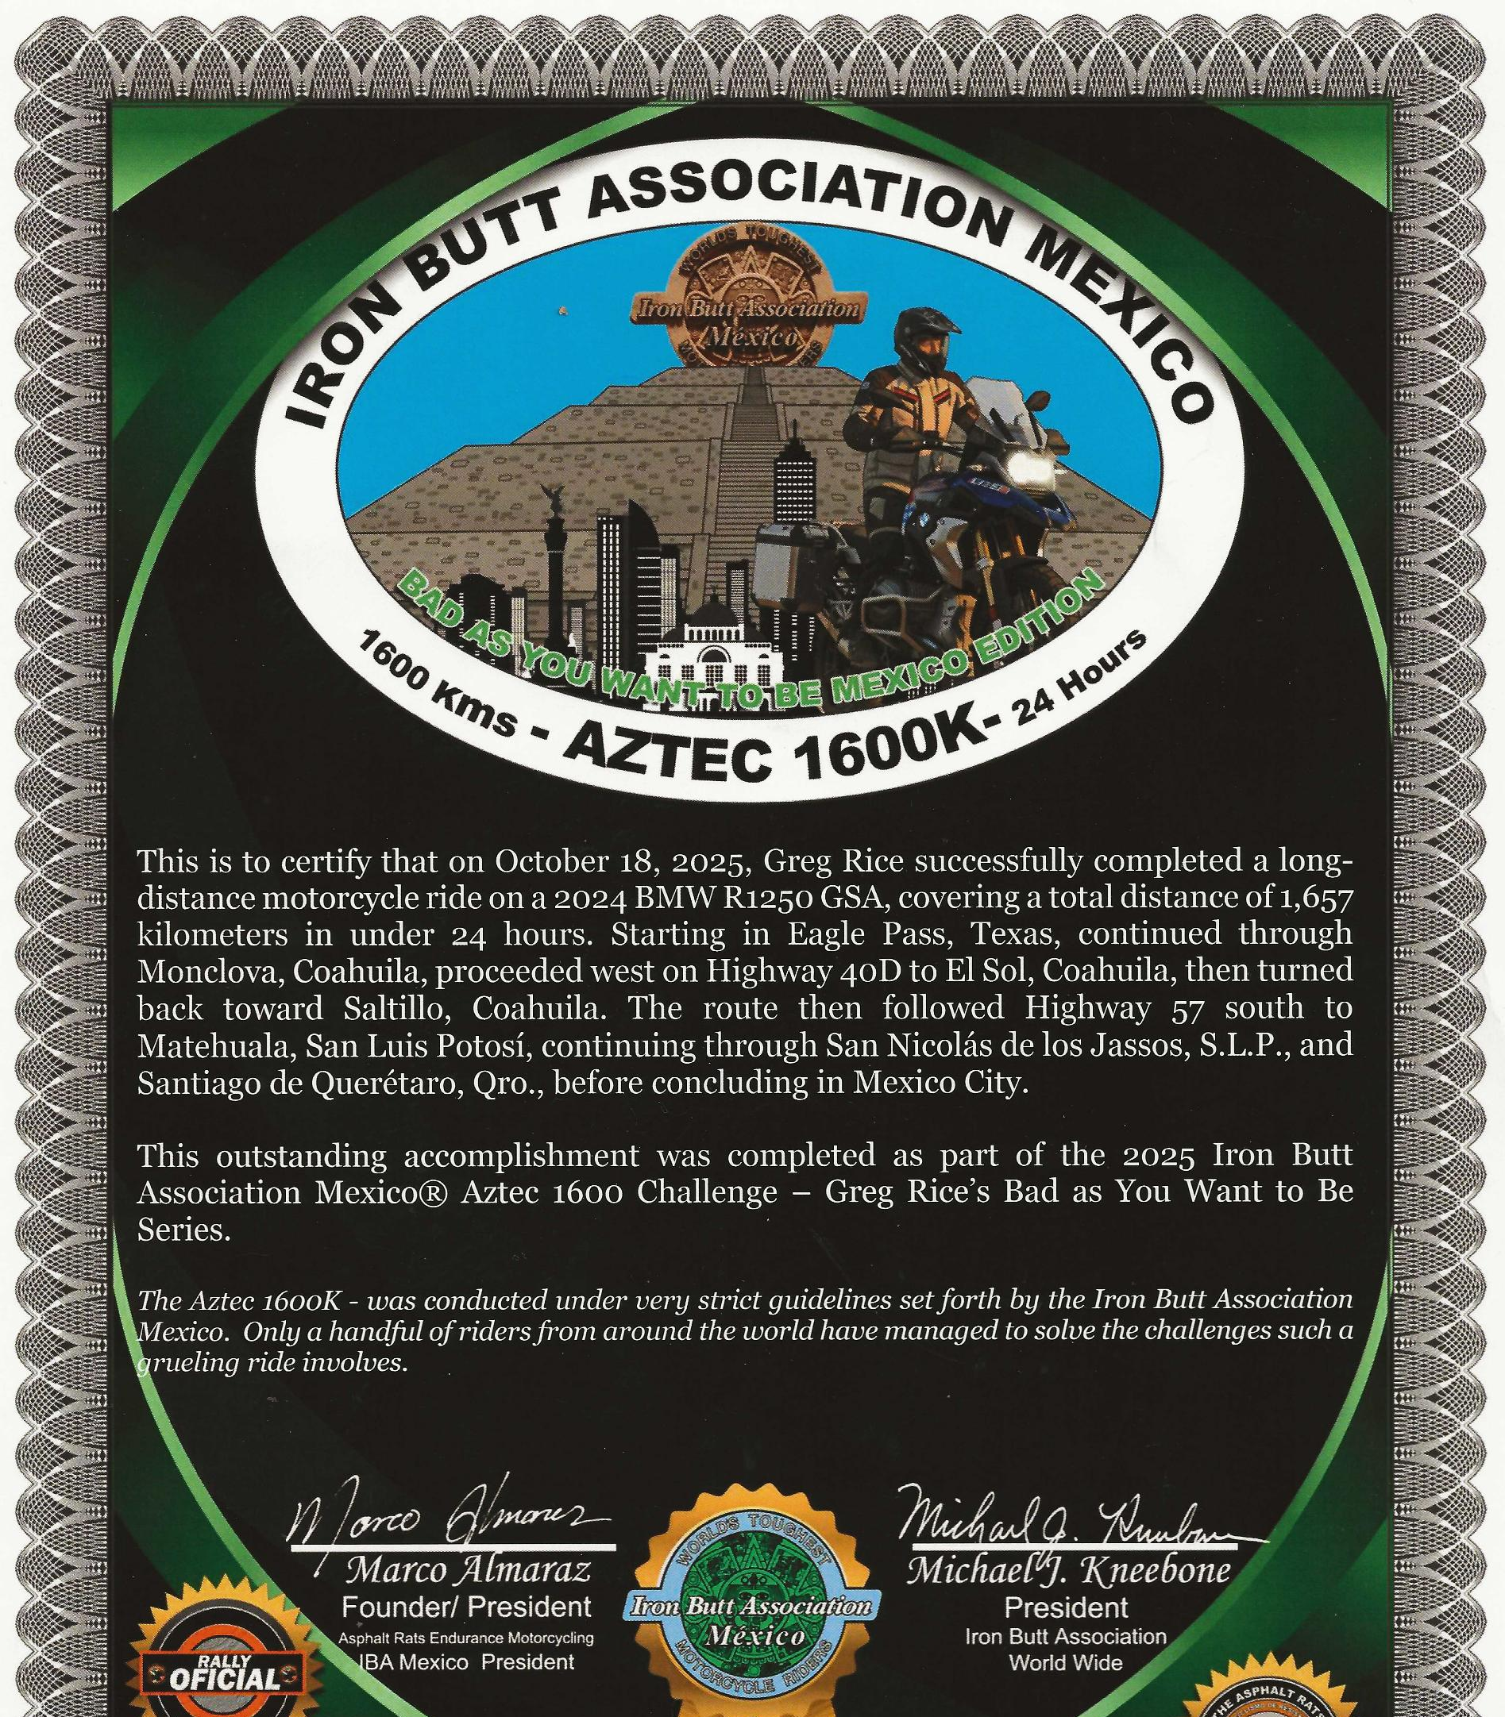
Big Adventures On Two Wheels: Riding South Of The Border - Mexico

Slide 39
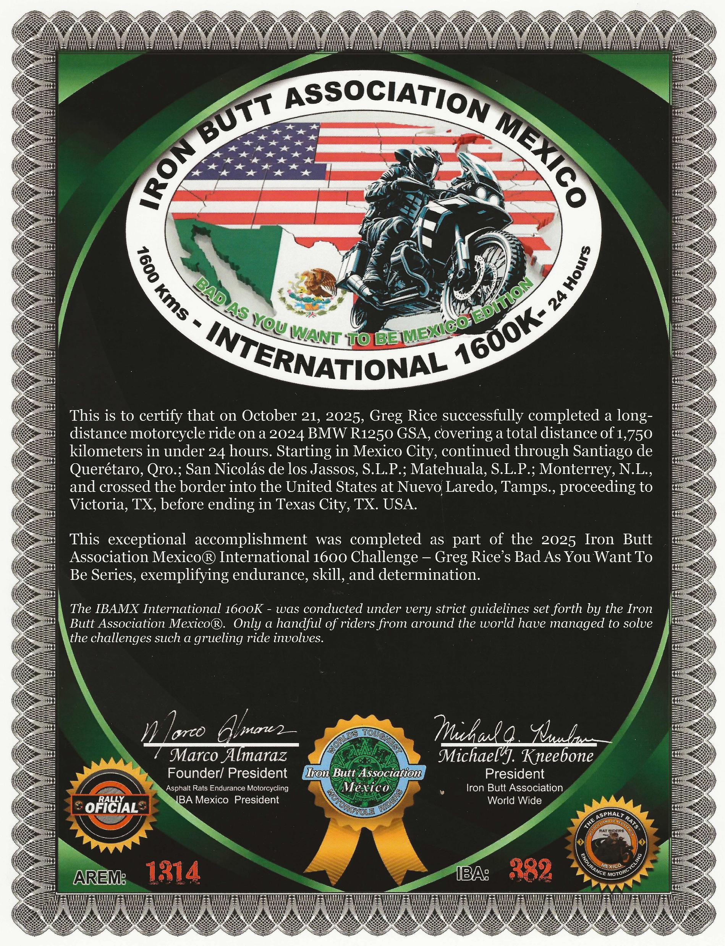
Big Adventures On Two Wheels: Riding South Of The Border - Mexico

Slide 40
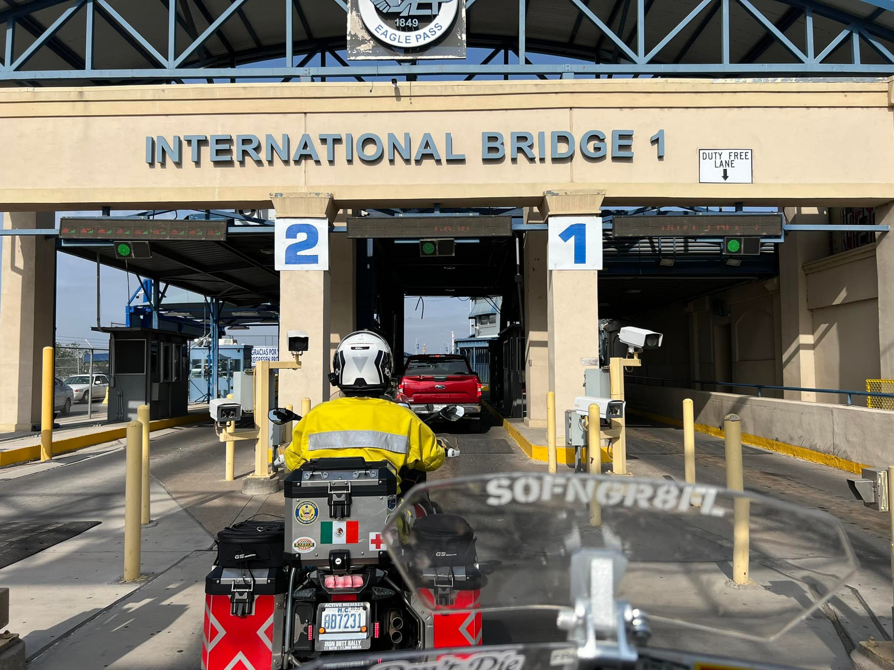
Big Adventures On Two Wheels: Riding South Of The Border - Mexico

Slide 41
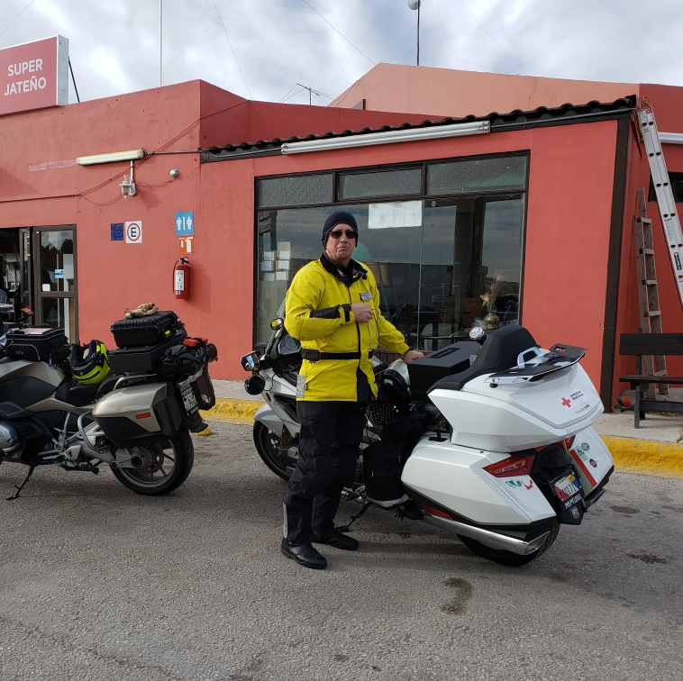
Big Adventures On Two Wheels: Riding South Of The Border - Mexico

Slide 42
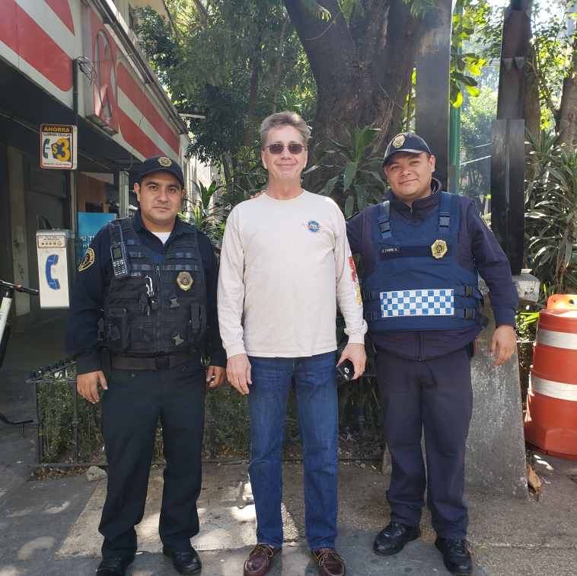
Big Adventures On Two Wheels: Riding South Of The Border - Mexico

Slide 43
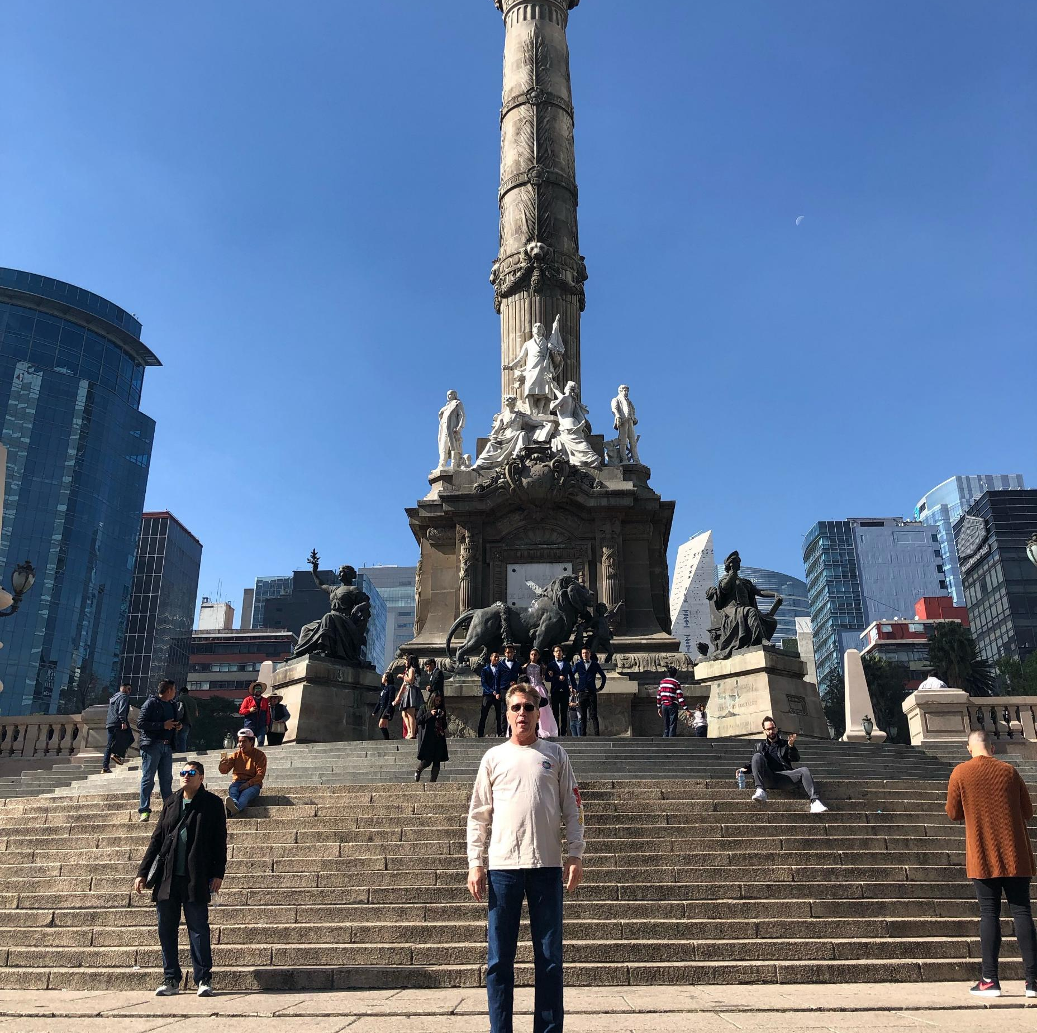
Big Adventures On Two Wheels: Riding South Of The Border - Mexico

Slide 44
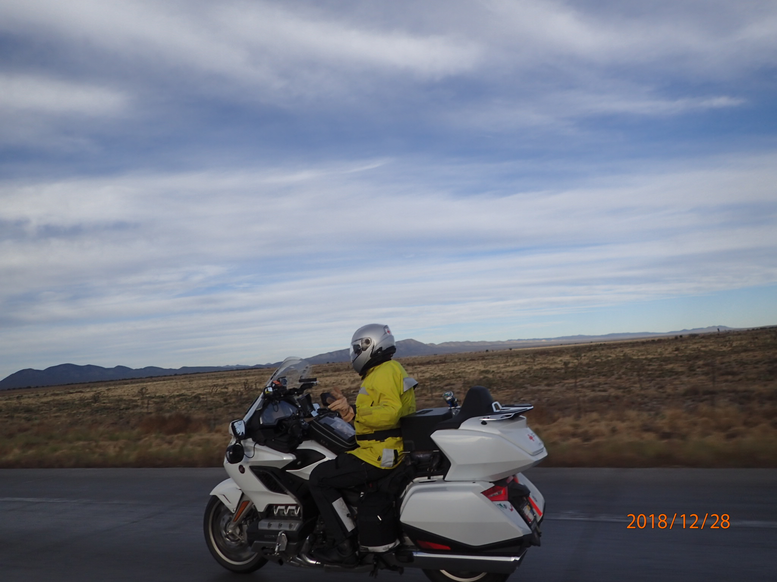
Big Adventures On Two Wheels: Riding South Of The Border - Mexico

Slide 45
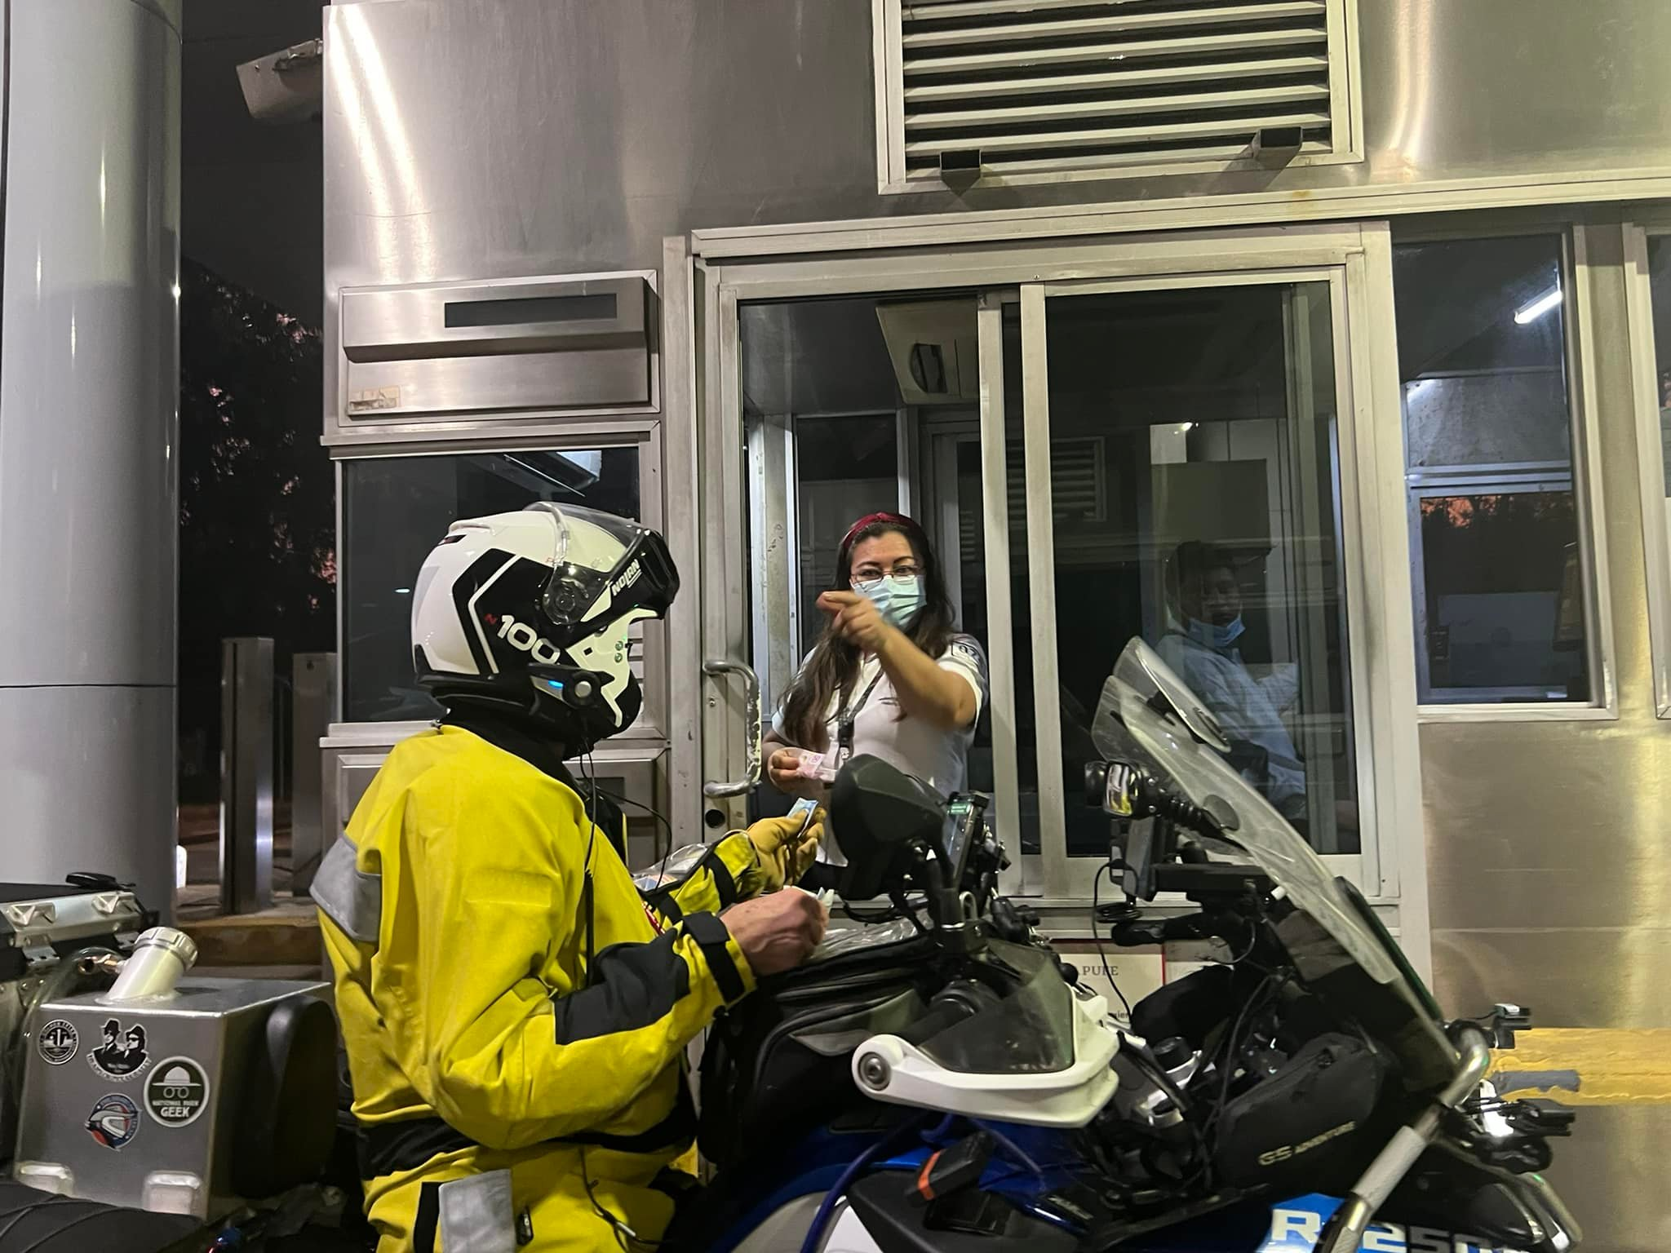
Big Adventures On Two Wheels: Riding South Of The Border - Mexico

Slide 46
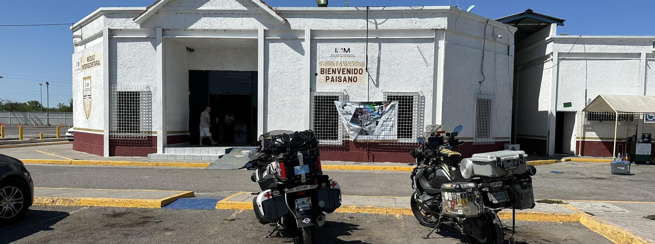
Big Adventures On Two Wheels: Riding South Of The Border - Mexico

Slide 47
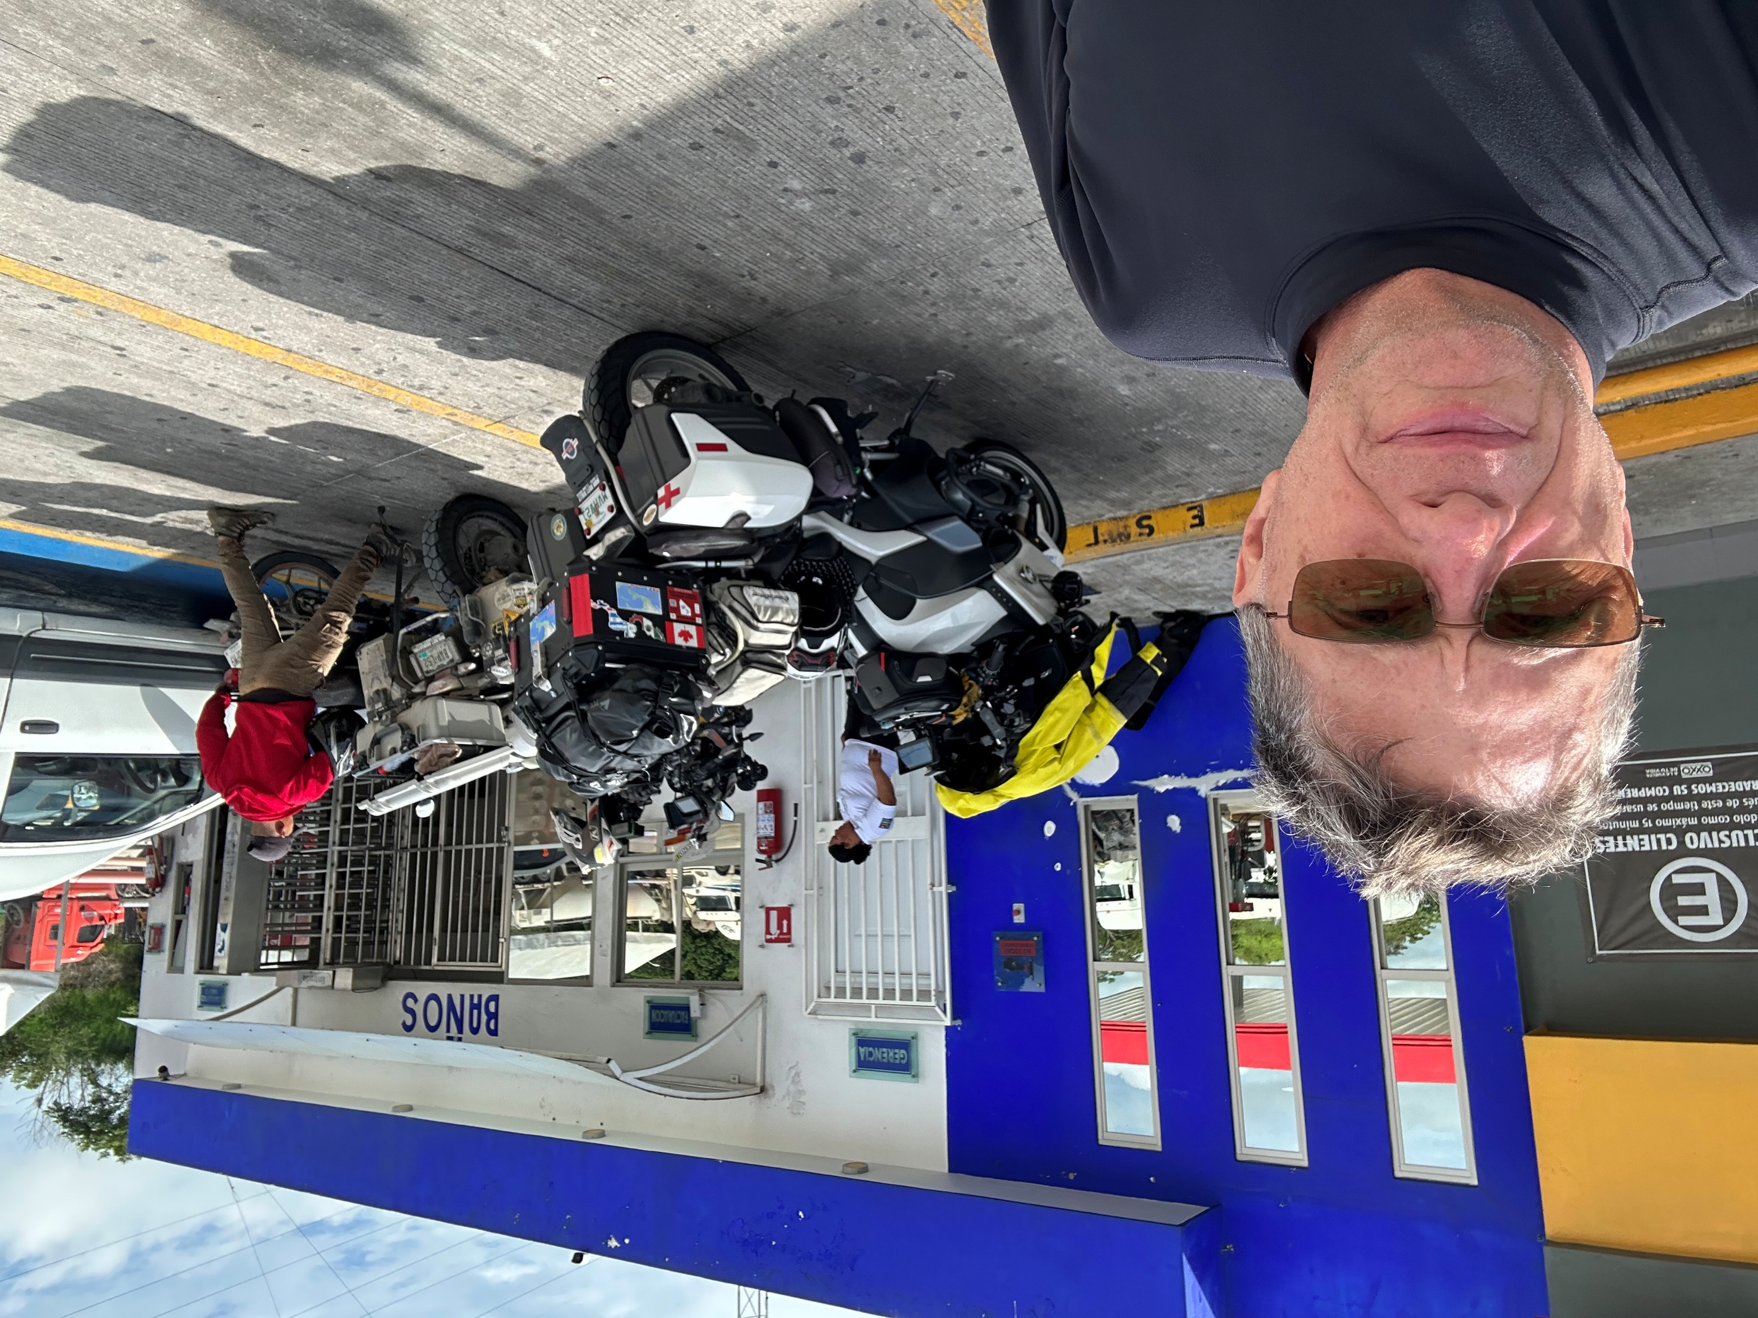
Big Adventures On Two Wheels: Riding South Of The Border - Mexico

Slide 48
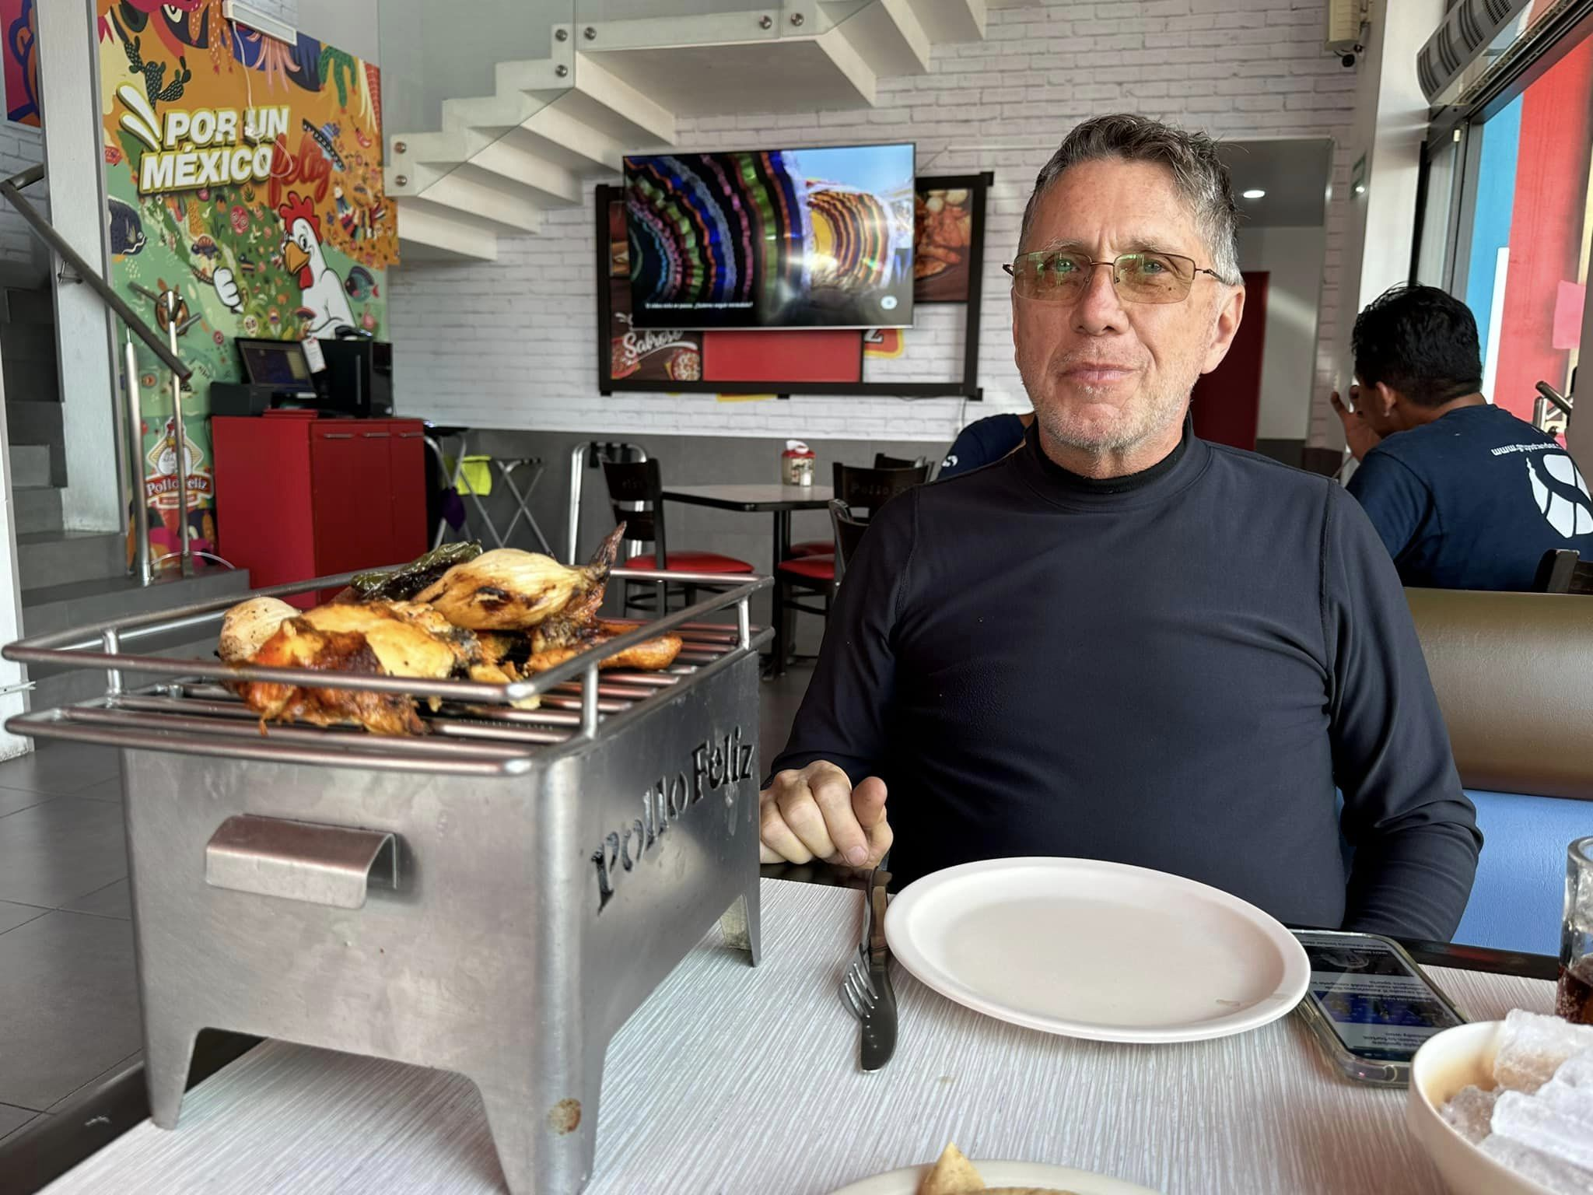
Big Adventures On Two Wheels: Riding South Of The Border - Mexico

Slide 49
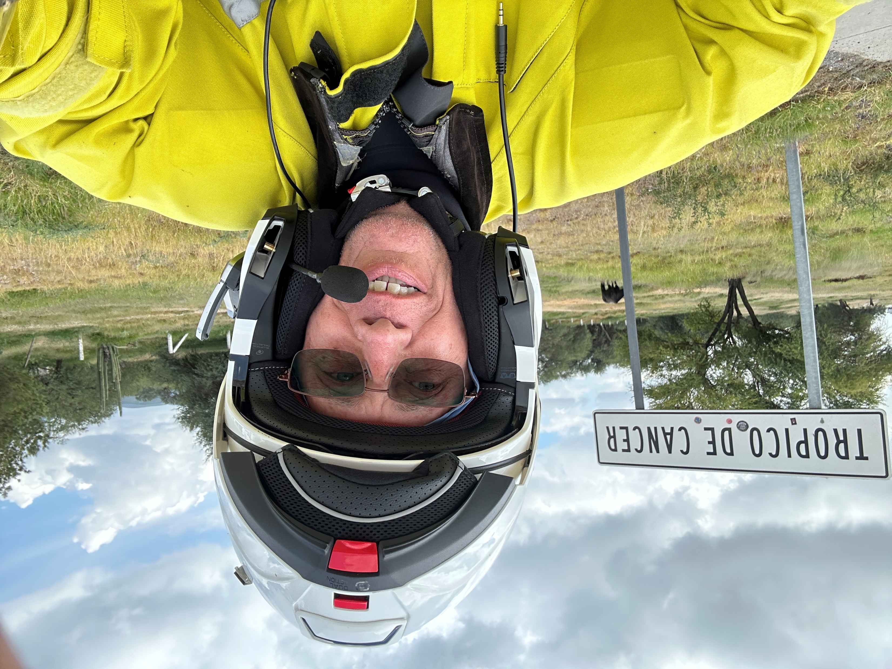
Big Adventures On Two Wheels: Riding South Of The Border - Mexico

Slide 50
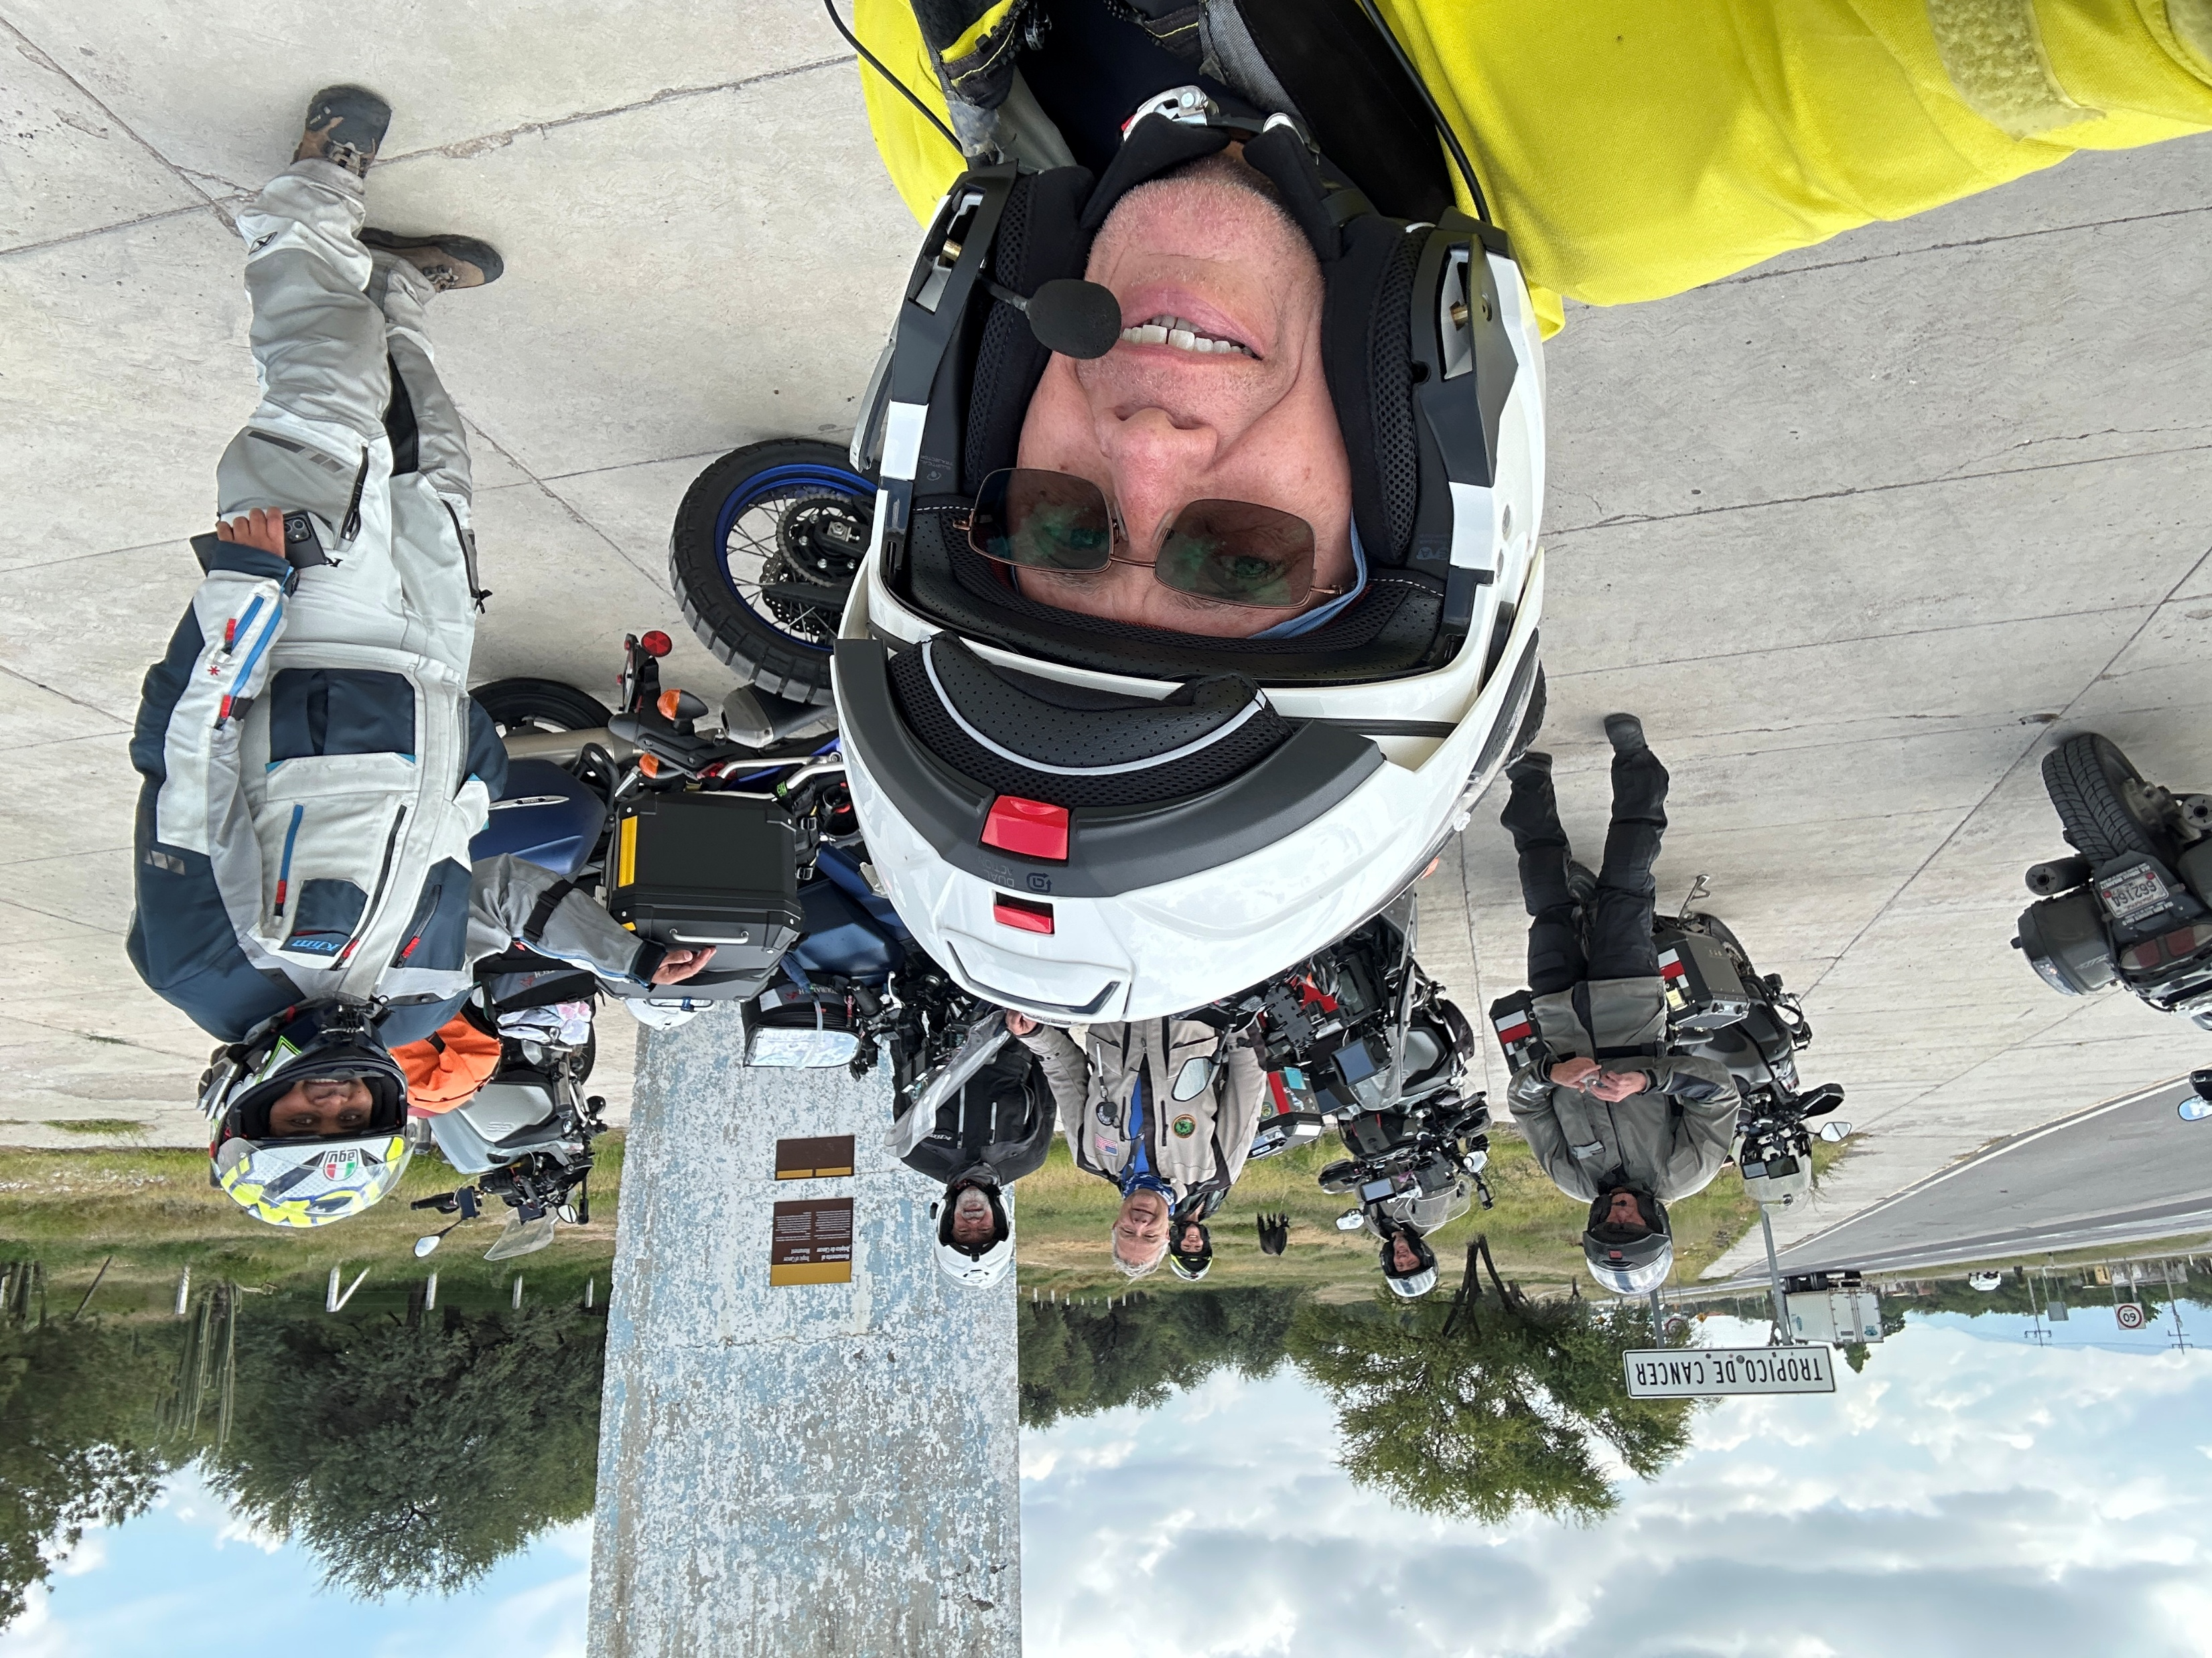
Big Adventures On Two Wheels: Riding South Of The Border - Mexico

Slide 51
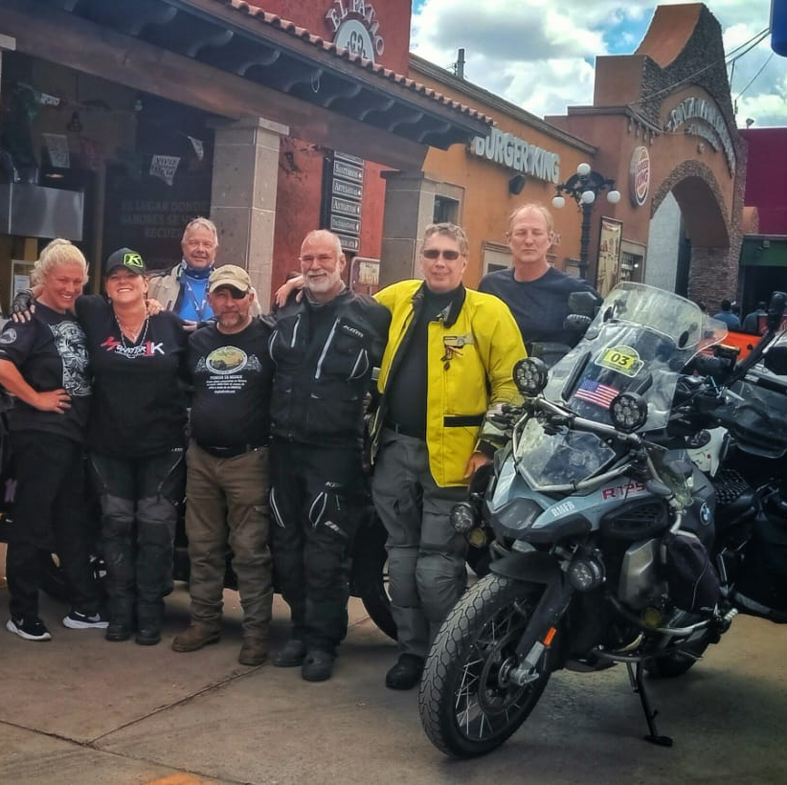
Big Adventures On Two Wheels: Riding South Of The Border - Mexico

Slide 52
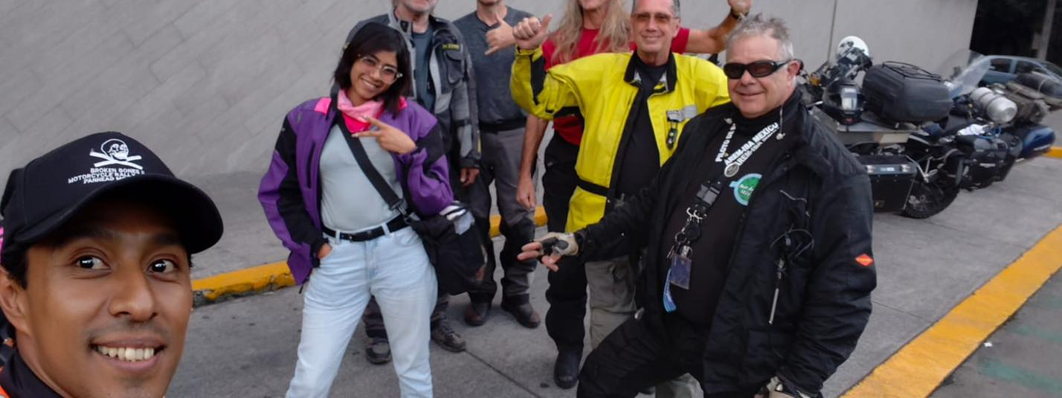
Big Adventures On Two Wheels: Riding South Of The Border - Mexico

Slide 53
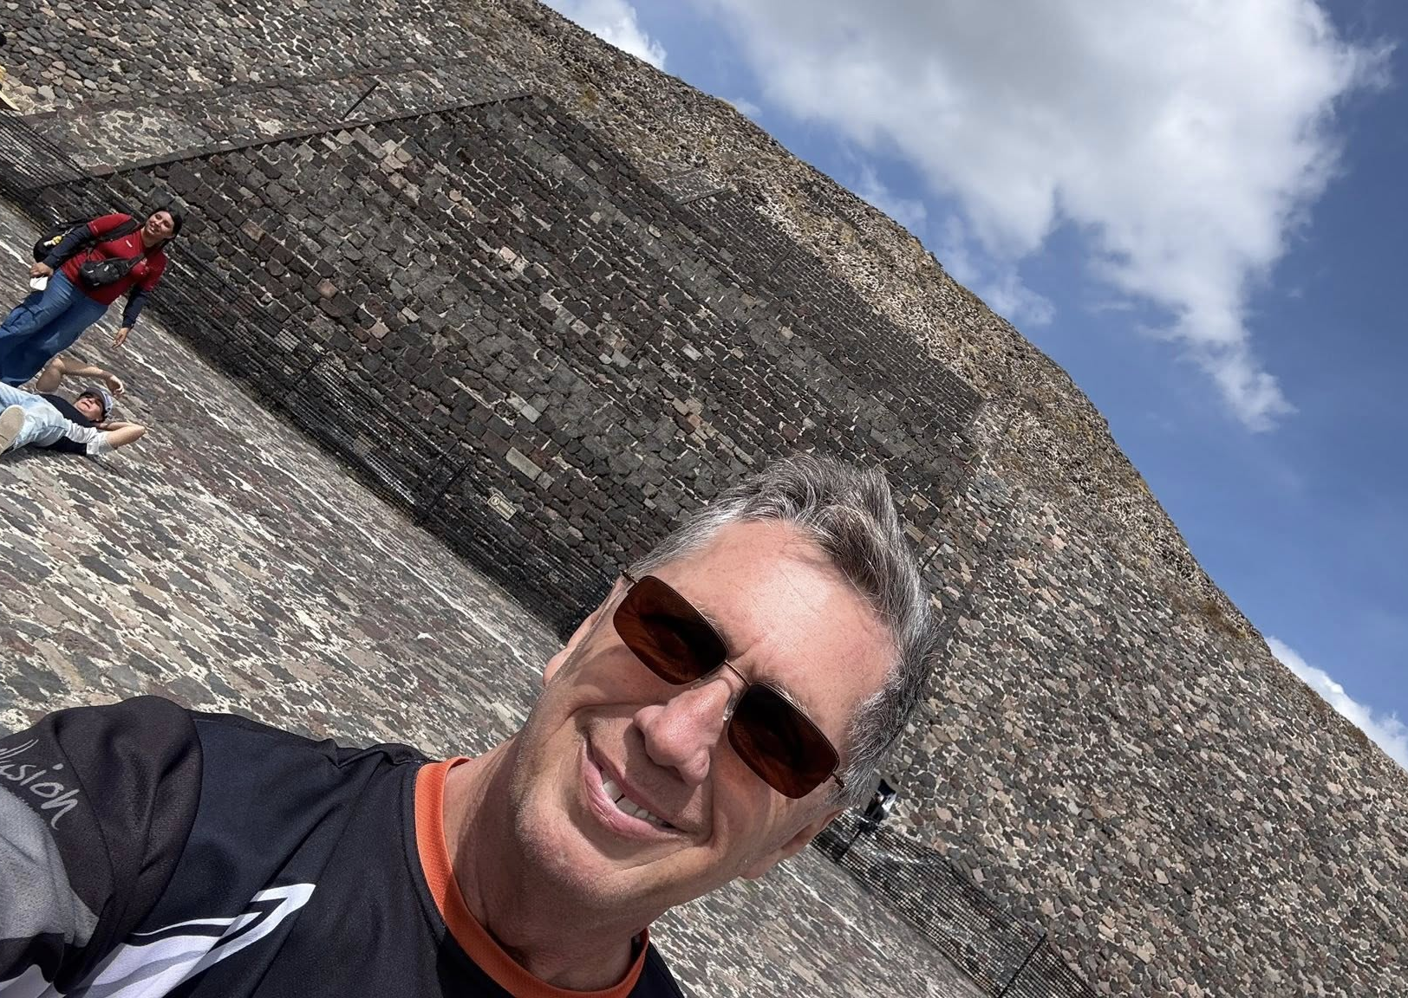
Big Adventures On Two Wheels: Riding South Of The Border - Mexico

Slide 54
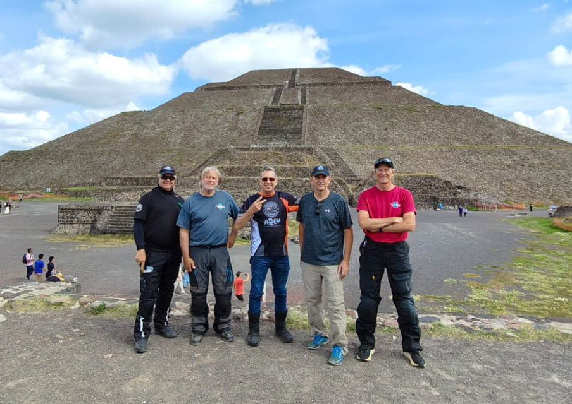
Big Adventures On Two Wheels: Riding South Of The Border - Mexico

Slide 55
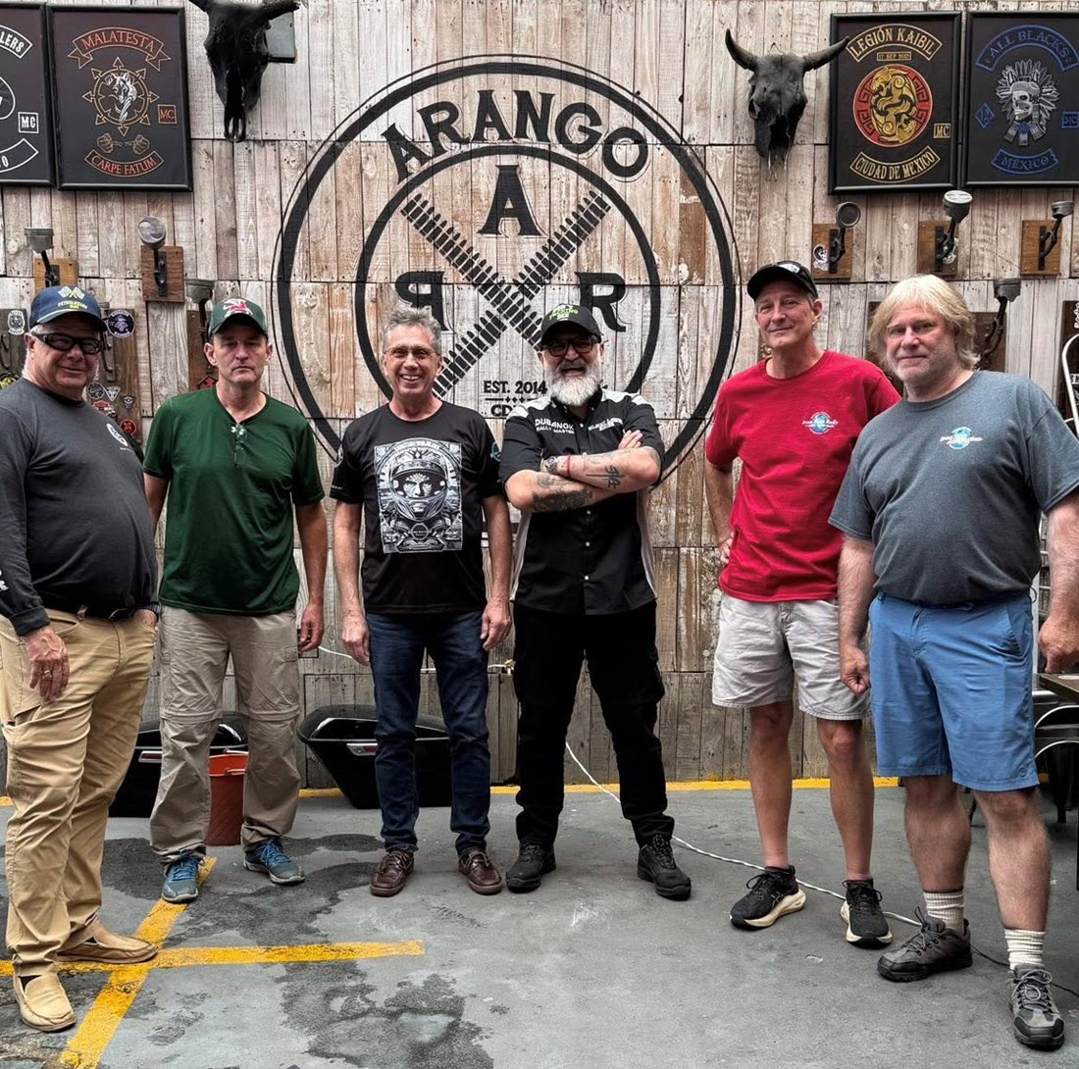
Big Adventures On Two Wheels: Riding South Of The Border - Mexico

Slide 56
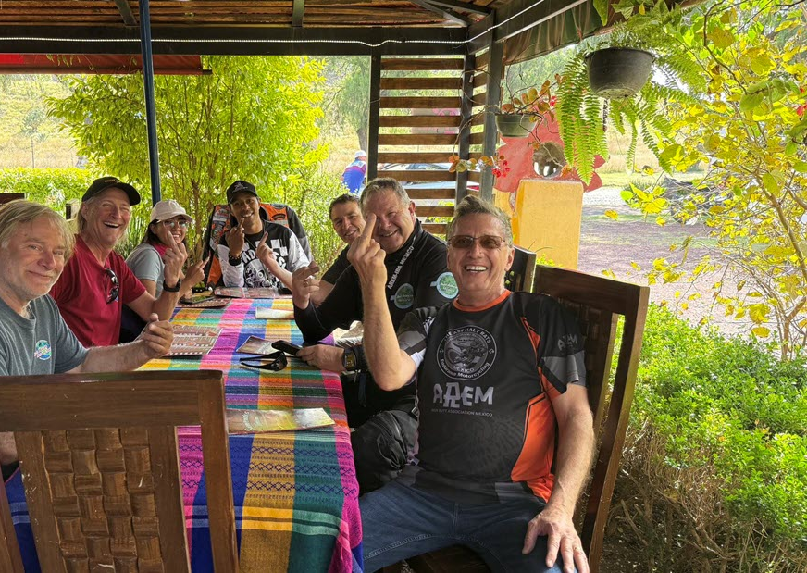
Big Adventures On Two Wheels: Riding South Of The Border - Mexico

Slide 57
Big Adventures On Two Wheels: Riding South Of The Border - Mexico

Slide 58
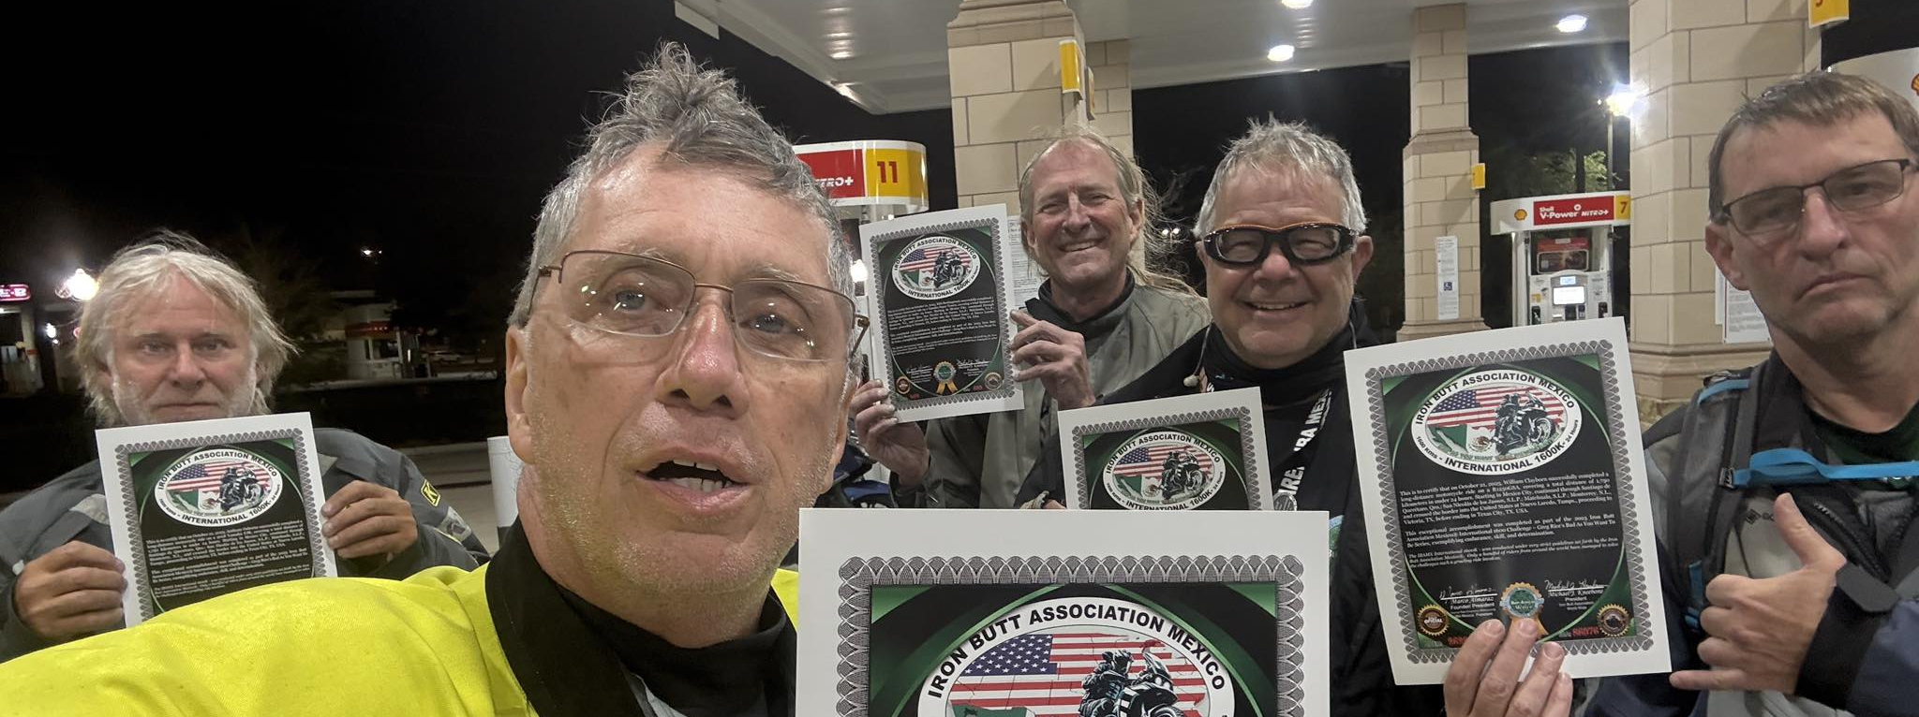
Big Adventures On Two Wheels: Riding South Of The Border - Mexico

Slide 59
Q&A
Big Adventures On Two Wheels: Riding South Of The Border - Mexico

